Slide 1

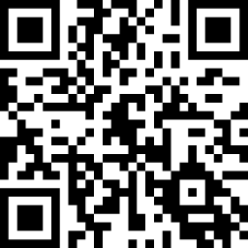
Please fill out the “Trainee Information Form”
http://go.rutgers.edu/register

Slide 2

Please fill out the Course Evaluation
http://go.rutgers.edu/oshaeval

