Slide 1
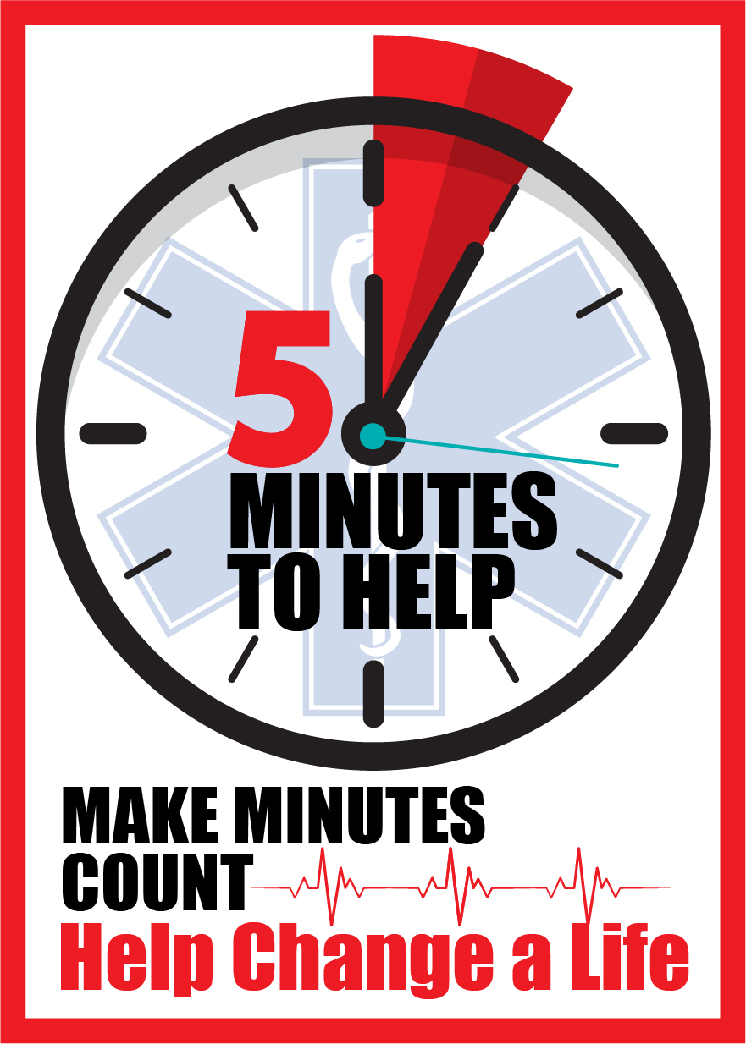
Five Minutes to Help
Updated April 2025
Notes:
The purpose of today’s training is to help first responders develop new knowledge and communication skills that can be applied on the scene, post overdose reversal, to encourage Substance Use Disorder (SUD) patients to seek help for their addiction and make them aware of available resources
Five Minutes to Help was envisioned by the NJ Department of Health’s Office of Emergency Medical Services, and the content in today’s training was developed by the Rutgers School of Public Health, with funding from the NJ Department of Health’s Overdose Data to Action (OD2A) CDC grant
This is a four-hour session, and 4 EMS CEUs will be issued upon completion of your evaluation; we will provide the link to the online evaluation at the end of the training
Some of the content in this training may be sensitive for some people. If you ever feel triggered or upset, feel free to step out of the room for a few minutes to reset.

Slide 2
Why are we here?
Up to 20% of individuals who EMS providers administer Narcan to refuse transport to a hospital or leave the ER before being seen by a healthcare provider.
First responders are often the only healthcare professionals to interact with those patients.
Notes:
EMS data shows that up to 20% of individuals who EMS providers administer Narcan to refuse transport to the hospital or leave the Emergency Room before being seen by a healthcare provider. However, this percentage is likely significantly higher due to several identified factors, such as public access to free naloxone, poly-substance overdose, data, and other reporting limitations.
This puts EMS providers in a unique position because it means that they are the only healthcare professional the patient will interact with that day
As a first responder, you can encourage those patients to seek help and provide resources for them. This class will give you skills to be able to do that

Slide 3
Goal of Five Minutes to Help
To provide first responders with new skills in
motivational interviewing
and other communication techniques to apply
after revival from an opioid overdose.
Notes:
The goal of today’s training is to train first responders and other public health professionals in basic Motivational Interviewing and other communication techniques to apply after reviving a patient from an overdose
That being said, we understand what it’s like when an individual has been revived with Narcan – they may be experiencing a range of emotions and may not be willing or even able to hear what you are saying. We realize that you may only have successes with a select number of patients, but this class will teach you how to plant a seed with some patients so they will know that there is help available if/when they are ready
This country needs a new approach for addressing the opioid epidemic and this class is one way that we can do our part to help

Slide 4
Objectives
After the training, participants will be able to:
Describe the stigma & stereotypes associated with substance use.
Identify several approaches for addiction treatment and harm reduction.
Explain the stages of behavior change.
Demonstrate basic motivational interviewing techniques as a communication tool.
Notes:
Review key objectives
Our objectives are NOT to put every patient into substance use treatment or to turn you into a therapist from this 4-hour training
Throughout this training, we want to hear about your experiences from interactions with patients
We are not asking you to spend hours with patients to get them to go to treatment
You are not going to be a therapist or addiction counselor by the end of this training
We are asking you to spend about 5 minutes to talk with your patients with empathy about their options to get help (that's why this training is called Five Minutes to Help)
We are also asking that you learn about the resources available in the state and in your communities so you can tell your patients about the support that is available for them
The purpose of this training is to give you more skills in your toolbox to help your patients and communities

Slide 5
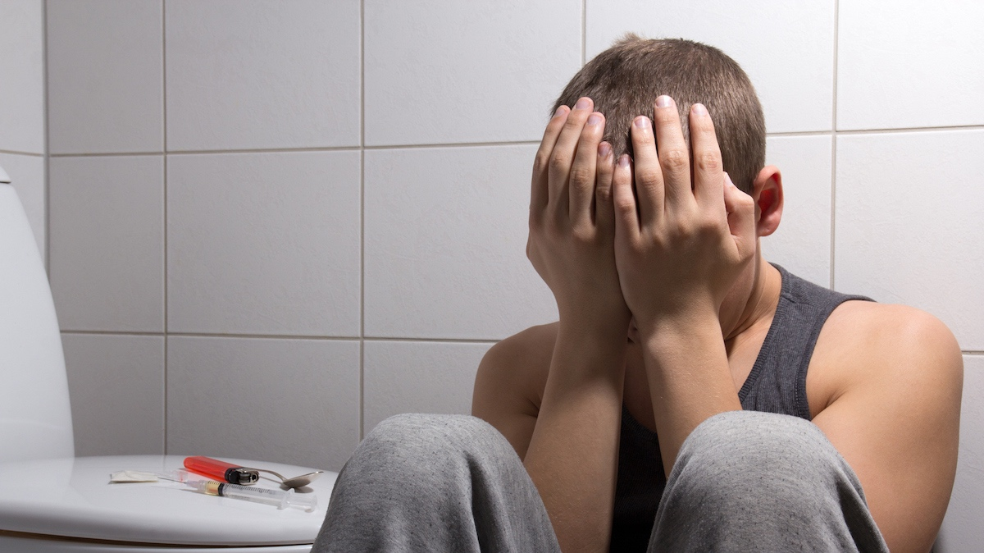
“If you didn’t offer me treatment when I didn’t want it, I wouldn’t be here to take the treatment when I was ready.”
Notes:
This is a real quote from someone receiving treatment for an opioid addiction
While of course not every person who uses substances will be responsive every time, some will be ready
Your job is to make sure the patients who are not ready know that help is available if/when they want it and to connect patients who are ready for help to recovery resources
Our goal as we go through today’s training, and as you apply the communication techniques out in the field, is to try to connect with patients and to encourage them to get help if/when they are ready
ONE IDEA: Have someone from the class read this statement out loud – and then an instructor can read the letter
Instructors: you may read the letter form an individual in recovery out loud or give it to participants as a handout and encourage them to read it during a break. The letter is available on the instructor website.

Slide 6
Section 1
Compassion Fatigue

Slide 7
Discussion about Successes & Frustrations
What successes have you experienced during an overdose call?
Notes:
Interactive Activity: Discussion about Successes (5-7 minutes)
Ask:
How many people in the room have treated an overdose patient before?
Based on your experiences treating overdose patients, what are some of the successes you have experienced with overdose reversal?
Remember that successes can be small – even if it doesn't feel like a big deal to you as a first responder, it may be a big success for the patient
Some examples of successes include:
Patient went to the hospital
Connected patient with a recovery resource
Patient survived
Left Narcan or other resources behind with a patient, friend, or family member
Had a conversation with a patient about their substance use

Slide 8
Discussion about Successes & Frustrations
What frustrations have you experienced during an overdose call?
Notes:
Interactive Activity: Discussion about Successes (5-7 minutes)
Ask:
How many people in the room have treated an overdose patient before?
Based on your experiences treating overdose patients, what are some of the successes you have experienced with overdose reversal?
Remember that successes can be small – even if it doesn't feel like a big deal to you as a first responder, it may be a big success for the patient
Some examples of successes include:
Patient went to the hospital
Connected patient with a recovery resource
Patient survived
Left Narcan or other resources behind with a patient, friend, or family member
Had a conversation with a patient about their substance use

Slide 9
Compassion Fatigue
Secondary traumatic stress + Burnout =
Compassion Fatigue
Mental stress resulting from exposure to other people’s traumatic events, which negatively impacts first responders’ mental/physical health and general wellbeing
www.ncbi.nlm.nih.gov/pmc/articles/PMC4924075/
www.ems1.com/public-health/articles/compassion-fatigue-the-hidden-danger-of-concurrent-national-public-health-emergencies-iql86uQ0tRIIDt1N/
Notes:
Compassion fatigue is very common among first responders, and it is okay if you are experiencing it – you are not alone
Secondary stress from treating trauma again and again in addition to burnout can lead to compassion fatigue
The definition of compassion fatigue is mental stress that results from exposure to other people’s traumatic events, which can negatively impact your mental or physical health and wellbeing

Slide 10
Compassion Fatigue
Signs/Symptoms:
Depression
Anxiety
Feeling burnt out
Exhaustion
Irritability
Dissatisfaction with work
Post Traumatic Stress Disorder (PTSD)
www.ncbi.nlm.nih.gov/pmc/articles/PMC4924075/
www.ems1.com/public-health/articles/compassion-fatigue-the-hidden-danger-of-concurrent-national-public-health-emergencies-iql86uQ0tRIIDt1N/
Notes:
Some of the symptoms of compassion fatigue are depression, anxiety, feelings of being burnt out, exhaustion, irritability, feeling dissatisfied with work, and PTSD

Slide 11
Notes:
Interactive Activity: Breathing Exercise (4-5 minutes) (optional)
Instructors: you may decide if you would like to facilitate this activity or not
First responders experience a lot of stress during their jobs, but there are simple things you can do to help with that, such as taking a moment to practice deep breathing
Let’s take a few minutes to get centered with deep breaths
Invite the group to place both feet flat on the ground and close their eyes
Release the tension in your shoulders, loosen your jaw
Lead group through a few slow deep breaths. Breathe in for 4 seconds, hold for 4 seconds, and breathe out for 4 seconds. Repeat 3-4 times
After doing this a few times, ask the participants to slowly open their eyes
You can always use this technique if you feel overwhelmed with a situation. It is a quick exercise, but is proven to be really helpful in stressful moments
Hopefully you now feel more centered and are ready to learn!

Slide 12
Section 2
Substance Use Disorder

Slide 13
Substance Use Disorder (SUD)
Substance use disorder/addiction is a chronic illness of the brain
No one chooses to develop SUD
SUD can be treated successfully with the necessary support and treatment
Notes:
When people use drugs, it changes their brain chemistry to make them physically addicted to the substance
However, no one chooses to develop a SUD
SUD can be treated successfully with support and treatment

Slide 14
Causes of SUD
Genetic predisposition for an addiction
Family history of SUD
Environmental influences
Co-occurring conditions
Social pressures
Use of drugs early in life
Injury leading to opioid prescription
Notes:
There are a lot of causes of SUD and this list is not exhaustive
Genetic predisposition – scientific studies show that addiction can be a hereditary disease because there is a gene that can make people more susceptible to becoming addicted to substances
Family history – living in a home where a parent, sibling, or other family member uses substances can lead someone to develop SUD
Environmental influences – our environment plays a big role in our health – even our zip code can be the biggest indicator of our health status
For example, living in a community in which there is easy access to drugs can lead a person to start using and develop SUD
Co-occurring conditions – having other mental health issues (ex. Depression, anxiety, PTSD) can make someone more likely to start using substances
Social pressures – we know that peer pressure, especially among adolescents, can lead people to start using
Use of drugs early on in life – when someone starts using substances at a young age, they are more likely to develop a SUD throughout their lifetime
Injury – in some cases, people who are injured are prescribed opioids for the pain, but get addicted and then turn to other drugs (ex. Heroin) when their prescription runs out
Again, this list is not fully complete, but the purpose of this slide is to explain that there are many causes of SUD. Any one or a combination of these factors can lead to addiction and these examples show that it is not someone’s choice

Slide 15
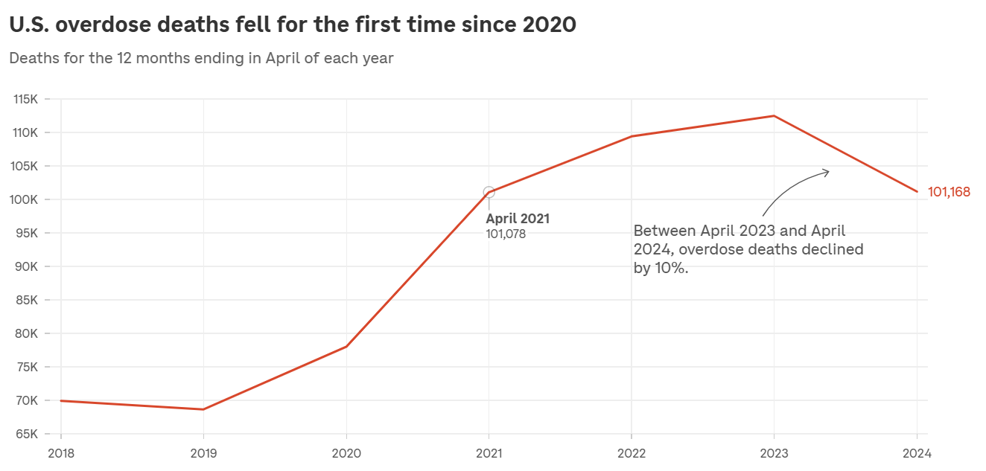
Recent Trends in Overdose Deaths¹
Between October 2023 and September 2024, the CDC reported a nearly 24% reduction in overdose deaths in the U.S.¹
70 lives have been saved every day as a result of the decrease¹
NJ follows a similar trend to the U.S. rates (graph to the right) with overall slightly lower overdose death rates^{2,3}
3
1. CDC Newsroom (February 2025)
2. National Center for Health Statistics (January 2025)
3. NPR (September 2024)
Notes:
Overdose deaths have declined in the past year, but the numbers of overdoses that happen everyday are still too high
This graph shows overdose trends over time for the U.S. and NJ follows a similar trend

Slide 16
Reasons for Recent Drop in Overdose Deaths
Data-driven distribution of Narcan¹
Higher frequency of people carrying Narcan with them²
Increased access to evidence-based treatment (ex. MOUD)¹
Financial investment in overdose prevention programs¹
Changes in drug supply (ex. Xylazine)²
Rapid identification of emerging drug trends¹
Researchers are still investigating the causes of the recent decrease in overdose deaths²
CDC Newsroom (February 2025)
NPR (September 2024)
Notes:
It is important to understand why we have seen a recent decrease in overdose deaths, but the truth is that researchers are not 100% sure why it is happening, although it is great to see
Distribution, availability, and use of Narcan has been effective in preventing death when an overdose does occur. Using a data-driven approach to distribute Narcan strategically to communities that need it most is important
Increased access to evidence-based treatment, such as MOUD, has supported many people in reducing or stopping use of opioids
Financial investment in overdose prevention, such as the grant that funds Five Minutes to Help
Changes in the drug supply – xylazine is a drug that prolongs the effects of fentanyl, but it also causes severe wounds on the skin. While it is an incredibly dangerous substance that people are using, it can make the effects of opioids last longer, which prevents people from using opioids as frequently, which can actually reduce overdoses
Researchers can now more quickly identify emerging drug trends, such as xylazine, to develop a quick approach to addressing those trends

Slide 17
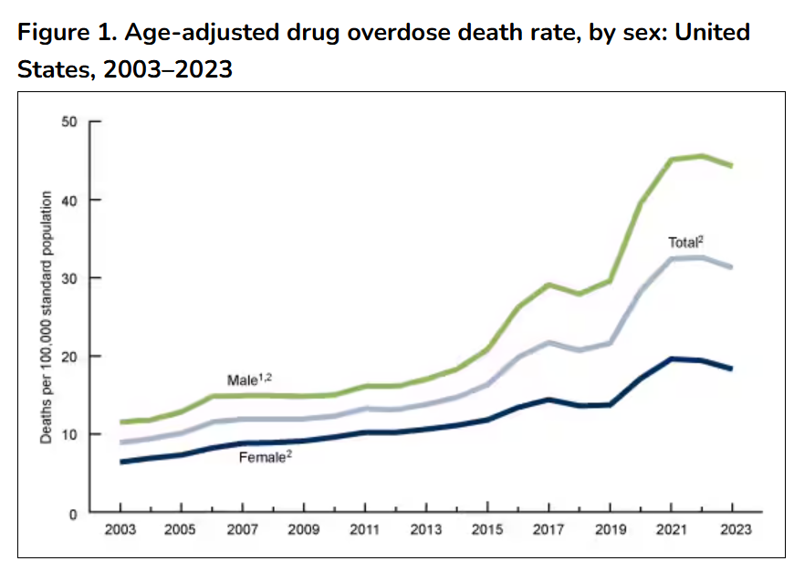
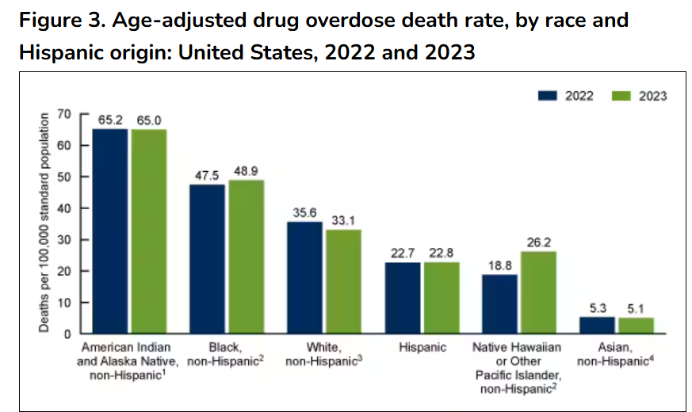
Disparities in Overdose Deaths
Key Takeaway:
Males have higher overdose rates compared to females.¹
Key Takeaway:
While overdose deaths in the U.S. decreased for White people, rates increased for Black, Hispanic, and American Indian people (2022-2023).¹
National Center for Health Statistics
Notes:
Males have higher overdose rates compared to females
There are still racial disparities in overdose deaths. Although overdose deaths decreased for White people in the U.S., rates have increased for people of color
These trends are important to be aware of because it helps us address these health disparities

Slide 18
Recurrence Rates are Similar for Addiction and Other Chronic Illnesses
Notes:
Relapse rates for addiction are similar to other chronic diseases, such as Type II Diabetes, hypertension, and asthma.
Relapse for addiction refers to using drugs again after not using for some time. This graph shows that the same can be said for these other chronic illnesses
It’s NOT about willpower and it is NOT a person’s fault for relapsing (it’s because of the chronic disease they are living with)

Slide 19
Important Note:
If there is an indicator of intentional
overdose/suicide, first responders must
follow standard protocols.
Notes:
If an overdose patient is showing signs of intentional overdose (ex. Suicide attempt), please follow the proper protocol for transporting that patient to the hospital

Slide 20
Section 3
Stigma Surrounding Substance Use Disorder

Slide 21
Notes:
Interactive Activity: Park Bench Scenario (10-12 minutes)
The purpose of this activity is to understand our biases about various types of drugs and the people who are using them
Before starting the scenarios, explain that the students should take off their “first responder/clinical hats” for a few minutes. For this activity, pretend you are a bystander, not responding to a call
Ask students to close their eyes and describe the first scenario below
Scenario #1
Pretend you are waling through a park, and you notice someone laying on a park bench. On the ground you see a bag with an empty liquor bottle partially exposed
Ask the students the following questions (one at a time):
What are your immediate perceptions of this person?
Describe the person you saw when you closed your eyes
What was the person they wearing?
What gender was the person you saw?
What do you think their life is like?
Scenario #2:
Pretend you are walking through the park again, but this time the person on the bench has a drop of blood running down their outstretched arm and a syringe is laying on the ground
Ask the students the following questions (one at a time):
What are your immediate perceptions of this person?
Describe the person you saw when you closed your eyes.
What was the person they wearing?
What gender was the person you saw?
What do you think their life is like?
How did your perceptions in Scenario #1 differ from your perceptions during Scenario #2?
Once you have heard answers from several people, explain that it is okay for us to have biases toward people, but we need to work on not judging them, especially before knowing the whole story
It is possible that some of us feel more bias toward people who use a certain type of drug.
For example, alcohol is legal for adults to use, so we have less bias toward the person in Scenario #1 compared to the person using an injection drug in Scenario #2

Slide 22
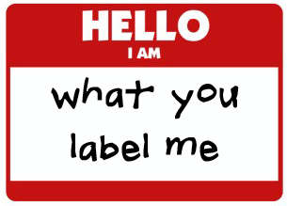
Notes:
Interactive Activity: What You Label Me (5-7 minutes)
The purpose of this activity is to provide a space for students to acknowledge their biases, and then figure out how to move past them to help our patients
Before starting the activity, explain to the students that this is a safe space and anything they say will be kept in the room
Ask: What are some words you have used or heard other people use to describe people with substance use disorder/addiction?
Give the students time to answer, but some responses may include: addict, junkie, frequent flyer, user, helpless, burden, etc.
If you are teaching an in person class, you can ask a volunteer to write down the answers on a white board if available
If you are teaching an online class, you can ask people to unmute and/or put their answers in the chat box
After you have received some responses, ask the students to use some empathy to reframe the way they think about people who use substances. All of these words are not necessarily true for every person who uses substances.
Ask: What are some more positive words that we can use to describe people who use substances or are in recovery if we have some empathy for them? What about someone you know who has used or is using substances?
Give the students time to answer, but some responses may include: resilient, resourceful, someone’s family member/friend, lonely, hard worker, etc.
Use Chat Box or white board to track responses
The purpose of this activity is for the students to understand that whether or not someone is currently in recovery, they all have strengths and positive traits

Slide 23
Individuals living with Addiction Need Support,
Not Stigma
Junkie. Stoner. Crackhead. Addict. Alkie.
These ​words are dismissive and dehumanizing
We need to change the national discussion
We should use Person-First Language instead.
AMA Task Force to Reduce Opioid Abuse
Notes:
Thank the participants for openly discussing the terms that we may use and the people around us may use to describe people living with substance use disorder
Using language like this is dehumanizing and studies show that the stigma that is perpetuated from negative language can hinder people’s ability and willingness to access SUD treatment
Now we are going to talk about more effective ways to reframe the way we think about and describe people living with SUD
The purpose of person first language is to take the focus off of the individual’s disease, and allows us to see them as a person
Let’s all commit to trying to remove the terms we just spoke about from our vocabulary and start to use person first language instead (next slide shows examples)

Slide 24
Reducing Stigma by Using Person-First Language
Words to Avoid | Words to Use
Addict, abuser | Person living with a substance use disorder (SUD)
Drug problem, drug habit, abuse | Substance use disorder, drug misuse, harmful use
Clean | Not actively using
Dirty | Actively using
Clean drug screen | Testing negative for substance use
Dirty drug screen | Testing positive for substance use
Former addict | Person in (long-term) recovery
Opioid replacement, methadone maintenance | Medication for Opioid Use Disorder (MOUD), Pharmacotherapy
Relapse | Recurrence
Addictionary: https://www.recoveryanswers.org/addiction-ary/
Notes:
The basic concept of person first language is to take the focus off a person’s character trait and to instead focus on who they are as a person
For example, we can say “the girl who is blonde” instead of “the blonde girl”
Person first language was originally developed by people living with disabilities to refocus on the people themselves, rather than their disability
Here are some examples of person first language and other words to use in our vocabulary that are more respectful to people living with SUD
Studies show that using the words in the right column reduce stigma and can actually increase people's ability and willingness to access SUD services
Changing the language that we use personally will also create change within our communities and EMS agencies – encourage the people around you to use person-first language too

Slide 25
Use Misuse
Amount
Intent
Frequency
Intent & Frequency
Increasing use
Daily use
Alone
Associated with most events
Requirement for fun
Hard to stop
Blackouts/ Overdose
Impact
Notes:
The term “misuse” usually refers to using a prescription drug not as prescribed by a doctor (ex. Using a higher or more frequent dose of Oxycontin than a doctor said to use)
Using substances does not always mean that someone has a substance use disorder (SUD)
Many people in this room may drink alcohol but are not addicted to it. The same can be true for all drugs, even if they are illicit
Some studies have shown that most people who are screened for using substances do not actually have a SUD
However, it is important to be able to identify the signs of a SUD, especially as first responders who are interacting with people who overdose
The intent and frequency of using drugs is usually the best way to be able to tell if someone has a SUD or is simply using substances

Slide 26
Section 3
Substance Use Disorder Treatment &
Harm Reduction

Slide 27
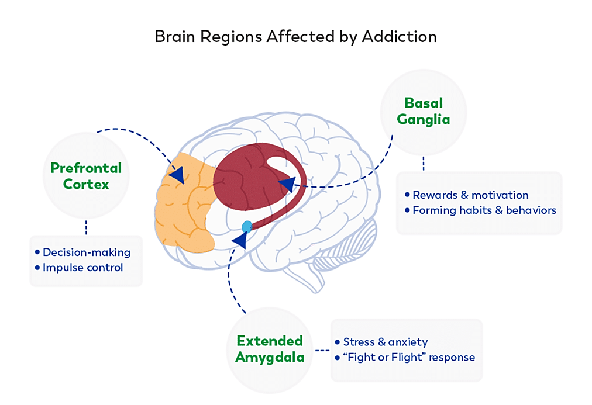
Three Functional Domains
1. Incentive Salience - (Basil Ganglia)
Substances affect the brain’s “reward circuit”, causing euphoria and flooding it with dopamine.
2. Negative Emotionally - (Extended Amygdala)
Increased anxiety, stress and painful symptoms of withdrawal
3. Executive Function - (Prefrontal Cortex)
Involved in decision making, self-control, and awareness.
Functional Domains of Substance Use
Neurobiology of addiction
Notes:
The brain has many regions that are interconnected with one another, forming dynamic networks that are responsible for specific functions, such as attention, self-regulation, perception, language, reward, emotion, and movement, along with many other functions.
Three regions are the key components of networks that are involved in the development and persistence of substance use disorders: the basal ganglia (Incentive Salience), the extended amygdala (Negative Emotionally), and the prefrontal cortex (Executive Function).
These domains explain how addiction affects a person's ability to function normally.
Incentive Salience: (Binge-intoxication)
Tolerance: the brain adapts by reducing cell ability in the dopamine receptors to respond to the substance(s) and the high felt decreases
The brain becomes overly focused on seeking the substance at the expense of other activities.
A person will need more of the substance to achieve a similar pleasurable effect.
Negative Emotionally: (Withdrawal –Negative affect)
Withdrawal is potentially life-threatening physical, behavioral, and cognitive symptoms that occur when a person dependent on a substance stops using.
Some of the signs and symptoms of opioid withdrawal include nausea and vomiting, muscle aches, inability to sleep, high blood pressure, rapid heartbeat, and agitation
Individuals continue to use substances to avoid withdrawal symptoms
Conditioning is based on the cause-and-effect relationship between a behavior and its consequences. When we reward a behavior, it tends to increase it, while punishment decreases it. (Pavlov's theory)
Understanding Drug Use and Addiction DrugFacts | National Institute on Drug Abuse (NIDA) (nih.gov)
Executive Function: (preoccupation – anticipation)
Binge and withdrawal cause long term frontal cortex changes which can provide insight into some of the behaviors of individuals with SUD.
Disruption of the Prefrontal cortex in addiction: Reinforces compulsive substance use and accounts for the adverse behaviors
Dysfunction of the prefrontal cortex in addiction: neuroimaging findings and clinical implications - PMC (nih.gov)

Slide 28
SUD Treatment can Help Someone…
Stop using drugs
Reduce the frequency of drug use
Reduce the risk of harm from using drugs
Be productive in the family, at work, and in society
Notes:
For some people, recovering from a substance use disorder may feel impossible, but there are many people in the world who have done it – you may even know someone who has successfully stopped using drugs or reduced frequency of using
Although treatment and recovery is possible, we need to recognize that there is not a one size fits all approach for this. Every single person who uses drugs has a different pathway that works best for them
It is also important to recognize that not everyone’s goal is to stop using drugs entirely. Some people simply want to stay safe while they are using drugs or use drugs while still being a productive member of society
Reducing stigma surrounding SUD means accepting that not everyone has the same journey

Slide 29
Components of Comprehensive SUD Treatment
Vocational Services
Family Services
Mental
Health Services
Types of Treatment:
Pharmacotherapy, Medication for Opioid Use Disorder (MOUD)
Hospital-based
Outpatient / Inpatient
Self-help
12-step recovery, Alcoholics Anonymous, Narcotics Anonymous
Spirituality / Faith-based
Family Support
• Assessment
• Evidence-Based Treatment
• Substance Use Monitoring
• Clinical & Case Management
• Recovery Support Programs
• Continuing Care
Legal Services
Medical Services
HIV/AIDS Services
Educational Services
Notes:
There are many ways to address the overdose crisis, and these are just some examples.
Medication alone is an effective treatment approach.
Some examples to address the crisis through comprehensive services are:
Vocational services – helping people get jobs so they are financially stable
Mental health services – providing support for people who want it
Medical services – wound care (especially for people who use xylazine/tranq), HIV and Hepatitis testing, treatment for other medical issues
Educational services - providing equitable education for everyone reduces the risk of developing a SUD
Legal services – helping people who have criminal records get jobs, decriminalizing drugs
Family services – helping families stay together whenever possible, using family as a motivator for recovery or staying safe

Slide 30
Harm Reduction
A set of practical strategies and ideas aimed at reducing negative consequences associated with drug use and preventing overdose deaths
A movement for social justice built on a belief in, and respect for, the rights and autonomy of people who use drugs
Daily examples of harm reduction
Seat belts
Helmets
Condoms
Vaccines
Masks
Designated drivers
Notes:
Besides treatment to help people stop using drugs entirely, there are other ways that we can help people living with SUD
The purpose of harm reduction is intended to meet people where they are at. It is an evidence-based intervention rooted in social justice
Everyone uses harm reduction in their daily lives
Seat belts - riding in a car can be dangerous, but we wear seat belts to minimize the risk of harm if we get into an accident
Helmets - riding a bike is also dangerous, but we ensure that ourselves and our children wear helmets to provide protection if we fall
Condoms, vaccines, masks, designated drivers, etc.
Harm reduction has always been used in public health, but the concept was first identified during the HIV/AIDS epidemic in the 1980s when activists found ways to reduce the spread of HIV

Slide 31
Harm Reduction
The intent is to reduce the risks associated with drug use
The purpose is NOT to force people to stop using drugs. The purpose is to keep people alive long enough for if/when they are ready to stop using
Evidence-based and effective in reducing overdoses and overdose deaths
Notes:
Harm reduction can also be applied to help people living with SUD use substances in a safer way
The purpose of harm reduction is NOT to force people to stop using drugs entirely. The purpose is to keep people alive long enough for if/when they are ready to stop using substances
Studies show that harm reduction reduces overdoses and overdose deaths, and it does NOT encourage people to use drugs

Slide 32
Examples of Harm Reduction
Overdose education + access to naloxone
Safer smoking/sniffing supplies, free needles / injection equipment, + testing strips for fentanyl and Xylazine
ARCH Nurses
There are Harm Reduction Centers in all 21 counties in NJ.
Condom Distribution
Community needle cleanup
SUD treatment and mental health care
HIV/Hep C Testing / PrEP
On-site counseling + referral to social services
Notes:
Harm Reduction Centers (HRCs) are community-based programs that provide a safe, trauma-informed, non-stigmatizing space for people who use drugs to access resources.
Most HRCs have integrated health care with SUD treatment and mental health care onsite.
There are Harm Reduction Centers in all 21 counties in NJ.
You should familiarize yourself with the resources that are available in your community/county so you can refer patients to them
Here are some examples of harm reduction and we will go into more detail on how they help on the next few slides
The NJ Department of Health is continuing to approve additional Harm Reduction Centers, so keep an eye out for more information about new ones opening near you

Slide 33
Benefits of Harm Reduction
Harm Reduction Strategy | Benefits
Naloxone education and access in communities | Community members/loved ones will know how to administer naloxone prior to first responders arriving.
Referral to SUD services or resources | Harm Reduction Centers can provide referrals to SUD resources Medication for Opioid Use Disorder (MOUD)
Infectious disease testing (HIV, Hepatitis, TB, etc.) | Provides access for treatment and medical care
Access to sterile syringes | Decreases spread of HIV/Hepatitis
Fentanyl Test Strips (FTS) | Detects presence of Fentanyl in a substance before use
Notes:
Studies show that harm reduction is extremely effective in preventing overdoses and overdose deaths
Instructors: Explain some of the examples on the slide (you do not have to cover them all)
Access to naloxone in the community – distributing naloxone to patients or loved ones can increase access to it in communities, which means someone will be able to administer it even before first responders arrive on the scene of the overdose. This is crucial to saving lives.
Referral to SUD resources – Harm Reduction Centers build trust between people who use substances and people who want to help. Once that trust is built, people may be more open to getting help when they are ready
Infectious disease testing - when people have access to testing for diseases that can spread through syringe sharing, this can provide opportunities for them to get treatment to prevent continued spread of disease
Access to sterile syringes – access to sterile syringes prevents the spread of diseases from sharing needles and can prevent a first responder from getting HIV or Hepatitis after an accidental needle stick
Fentanyl test strips – allows a person who is about to use a drug to test if it has fentanyl in it so they can decide if they want to use the drug or use less of it to prevent a fentanyl overdose. As of 2023, xylazine/tranq test strips are coming soon!

Slide 34
Medication for Opioid Use Disorder (MOUD)¹
What is MOUD?
How It Works
Purpose
MOUD is an evidence-based intervention that is proven to be effective in treating Opioid Use Disorder (OUD)
MOUD binds to the same receptors in the brain that opioids bind to, but MOUD doesn’t activate them as strongly, so it is safer to use
Curb cravings to prevent the use of opioids
Types of MOUD
Efficacy²
Buprenorphine
Methadone
Naltrexone
Suboxone (Buprenorphine + naloxone)
There is a 60% reduction in risk of death for the first 60 days that MOUD is used.
1. FDA: Information About MOUD
2. MOUD saves lives, especially after 60 days
Notes:
Medication for Opioid Use Disorder (MOUD) is considered to be the “gold standard” for opioid use disorder treatment to support people living with opioid use disorder (OUD)
It is rooted in evidence based medicine and is proven to be effective in reducing overdoses and overdose deaths
How it works: MOUD reduces opioid cravings so people are less inclined to use opioids
The medication binds to the same opioid receptors that an opioid binds to, but it is safe and does not produce that feeling of euphoria
Four types of MOUD are approved by the FDA: Buprenorphine, Methadone, Naltrexone, and Suboxone (which is a combination of Buprenorphine and naloxone)
In one study, there was a 60% reduction in risk (ex. Overdose, contracting infections that can be spread through sharing needles, etc.) in patients who used MOUD for 60 days, and an additional 10% risk reduction for every following 60 days up to a year. This study was conducted in 2018 (when fentanyl use was beginning to increase in the U.S. Although this study was conducted a while ago, the time frame it was done represents a time period when SUD was particularly problematic).

Slide 35
Discussion Question
Based on what you just learned about Medication for Opioid Use Disorder (MOUD), what do you think are some of the benefits?
Do you have any real life examples of success stories?
Notes:
Discussion (3-5 minutes):
Based on what you just learned about MOUD, what are some of the benefits?

Slide 36
Benefits of MOUD
Support people who choose to reduce or stop use of opioids
Increase the likelihood that a person will continue not to use substances
Reduce opioid use and associated symptoms
Decrease the risk of infectious disease transmission
Reduce the risk of an overdose related death
1. National Harm Reeducation Coalition
Notes:
MOUD supports people who are ready to reduce or stop the use of opioids
It increases the likelihood that someone will not continue use of substances and remain in recovery
Reduces opioid use and associated symptoms
Decreases the spread of infectious diseases that can be spread through sharing needles because they are not using substances
Has the potential to prevent an overdose related death

Slide 37
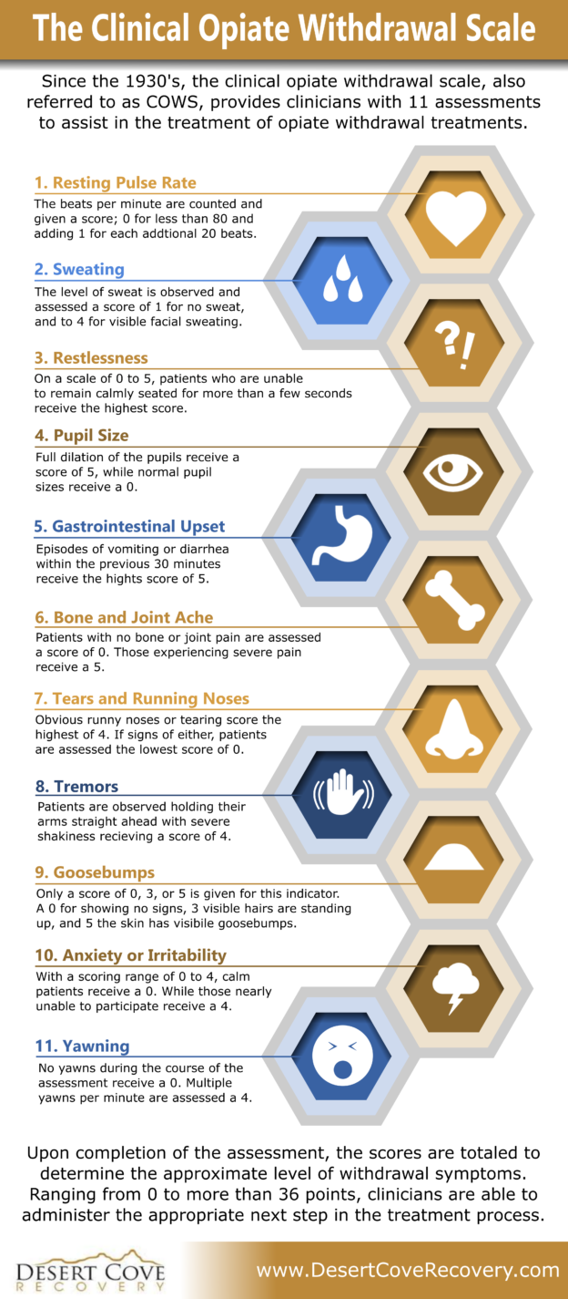
Increasing Access to MOUD
Policy: EMS clinicians can administer Buprenorphine to treat opioid withdrawal or manage OUD without the prerequisite of a patient receiving an opioid antidote (Executive Directive No. 25-001).
Clinical Opiate Withdrawal Scale (COWS): 11-item scale to rate common signs and symptoms of opiate withdrawal and to monitor these symptoms overtime.
Purpose: The total score can be utilized to determine the stage or severity of opiate withdrawal and assess the level of physical dependence on opioids to identify patients who can receive Buprenorphine.
Clinical Opiate Withdrawal Scale
Notes:
EMS clinicians can administer Buprenorphine to treat withdrawal symptoms
New Jersey was the first state in the U.S. to all EMS providers to do this
The COW Scale can be used to rate common signs and symptoms of opioid withdrawal and monitor them over time
The COWS score can be used to understand the severity of opioid withdrawal and identity patients who can receive Buprenorphine
Please review the link
https://www.sciencedirect.com/science/article/pii/S2688115224011688

Slide 38
Section 5
Resources

Slide 39
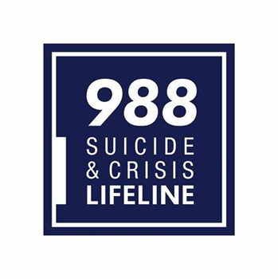
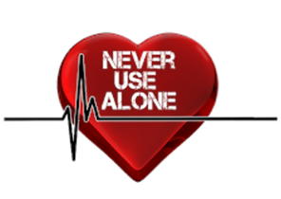
Resources
Notes:
Every person treating overdose patients should learn about the resources available in their community, county, and state.
Here are a few that you can learn about
ReachNJ is the state’s 24/7 addiction hotline that you can call with a patient to find out about nearby resources that fit the patient’s needs. Anyone can call ReachNJ regardless of insurance status or ability to pay
The 988 suicide and crisis lifeline is a national hotline that anyone can call if they are in crisis
Never Use alone: Call 877-696-1996 to speak to a non-judgmental peer operator available 24/7 who has lived experienced with Substance Use Disorder.
NJ State Police Operation RISE facilitates linkage to care for substance use disorder and recovery support services to communities through robust Data Analysis, Outreach/Intervention, and Training.
Naloxone 365: Pharmacies acquire naloxone through their normal network of medication distributors and after dispensing, bill the state utilizing a special NJMMIS/Medicaid billing code to receive reimbursement at the current Medicaid rate. Stopoverdoses.nj.gov
Instructors – feel free to add local resources to this slide too

Slide 40
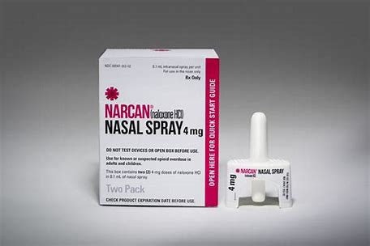
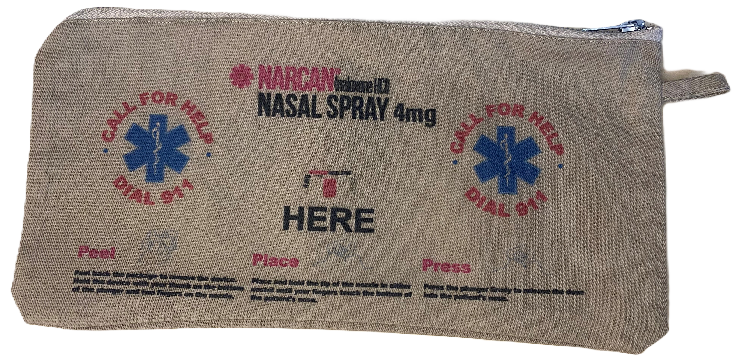
Naloxone Leave Behind
First responders must offer to leave naloxone and resources behind with a patient, friend, or family member post-overdose if the patient refuses transport to the hospital
Resources must include information about
Recovery
Treatment
Harm reduction
Passed in 2021 in NJ
Email 5MinToHelp@doh.nj.gov to receive FREE naloxone and resources.
Notes:
Requires all first responders (EMS, fire, and law enforcement) to offer to leave naloxone and recovery/harm reduction resources behind with a patient who refuses transport to the hospital after an overdose (or with a friend, family member, or bystander)
This is an example of harm reduction because it increases access to naloxone in the community in the event of an overdose
Naloxone Leave Behind law was passed in 2021 in NJ
Your agency can request to receive FREE naloxone and resources – email 5MinToHelp@doh.nj.gov.

Slide 41
Rapid Referral Platform
How it works:
EMS encounter with an individual living with SUD (often post-overdose)
Platform facilitates a rapid referral, offering medication vouchers, transportation vouchers, and peer referrals to assist individuals in getting to their first clinic appointment
Individuals are connected to outpatient treatment organization of their choice and seen in as little as 24 hours from their referral
NJ is in the process of implementing a referral platform to be utilized by first responders.
Notes:
Online platforms facilitate rapid referrals for individuals with SUD by connecting participating referral sites, receiving treatment organizations, peer support agencies, and pharmacies into one efficient process

Slide 42
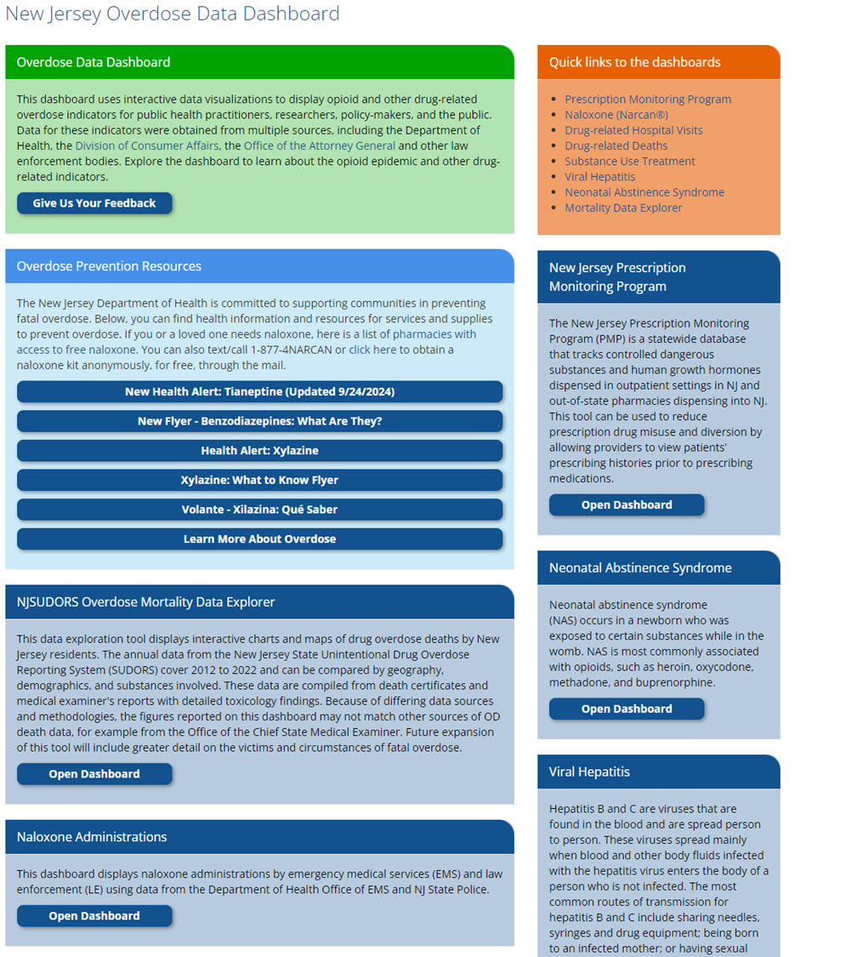
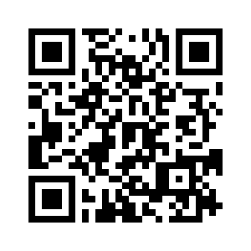
NJ Overdose Data Dashboard
https://www.nj.gov/health/populationhealth/opioid/
Notes:
This is NJ’s data hub for all data related to opioid use, reversals, and hospitalizations
If you want to learn more about current overdose statistics, we encourage you to spend some time on this site – you will find it very informative

Slide 45
Section 6
Behavior Change

Slide 46
Notes:
Now we are going to talk about the process of behavior change
We have all tried to change a habit/behavior and this is no different from someone trying to stop using substances or trying to use them in a safer way

Slide 47
Behavior Change Discussion Questions
What behavior/habit have you tried to change in your life?
What barriers/challenges did you experience?
Were you successful in changing behavior? Why or why not?
Notes:
Interactive Activity: Changing Habits (10-12 minutes)
The goal of this activity is to help people understand that everyone has tried to change a behavior at some point in their life and this is no different than someone trying to stop using substances or use substances in a safer way – we have all experienced this, struggled with this, and been successful with changing something in our lives
Instructors – you can choose to facilitate this exercise as a group or break up into groups of 2-3 people. If you have enough time, you can come back together as a group to discuss what people talked about in their smaller groups.
Ask participants to answer each question on the slide one at a time.
Some examples of behavior change are:
Losing weight
Quitting smoking
Stopping biting your nails
Less procrastination
Starting to exercise
Eating healthy
Changing jobs
Feel free to come up with your own examples from your life too and open it up for some people in the class to respond
Do NOT list the behaviors above without giving everyone a chance to answer, but if there is silence after you ask the question, you can give 1-2 of the examples above to get the conversation started
Changing a behavior can be taking something negative out of your life (ex. Losing weight) AND/OR adding something positive into your life (ex. Starting to exercise). Reframing behavior change in a positive way is important for this activity.

Slide 48
Dedicated to all the people who are weary….
….of trying to educate, advise, entice, convince, coax, cajole, persuade, sweet-­talk, smooth-­talk, guilt-­trip, bribe, manipulate, or otherwise get people to change.
Notes:
Ask a volunteer from the class to read this quote
The purpose of sharing this quote is to help everyone understand that forcing someone to change doesn’t usually work. Change must come from within, so we need to meet people where they are at

Slide 49
Stages of Behavior Change
Pre-Contemplation
(“I don’t have a problem”)
Contemplation
(“Maybe this is something I should consider?”)
Re-Occurrence
of Use (triggers, over-confidence)
Termination /
Ongoing Recovery
Maintenance
(“I’m feeling pretty good about what I’ve done!”)
Preparation
(“What do I need to do?” or “What will I need?”)
Action
(“Let’s Do it!”)
Notes:
The purpose of this slide is:
To understand the stages of behavior change
To be able to identify where people are in the stages of behavior change to help them move to the next stage
Participants do NOT need to necessarily memorize the stages of change, but the point is to understand that we all have stages that we go through to change so we can meet patients where they are instead of pushing them to do something they aren’t ready to do yet
Stages of behavior change:
Precontemplation:
People in this stage are not thinking seriously about changing and may not see their drug use/SUD as a problem
In their perspective, the pros of using probably outweigh the cons of using, which is why they continue the current behavior
Contemplation:
People in this stage may be considering the possibility of quitting or reducing substance use but feel ambivalent about taking the next step
Despite the pros of using, they are starting to experience some adverse consequences (which may include personal, psychological, physical, legal, social, or family problems)
Preparation:
They probably see that the cons of continuing to use may outweigh the pros and they are less ambivalent about taking the next step
People have usually made a recent attempt to change using behavior in the last year
They are usually taking some steps towards changing behavior. They believe that change is necessary and that the time for change is imminent
Action:
People in this stage are actively involved in taking steps to change their behavior. They may be in recovery/have not used substances for some period of time
Maintenance:
People have been in recovery and are able to successfully avoid triggers that may lead to using again
They have learned to anticipate and handle temptations to use and are able to employ new ways of coping
Re-Occurance:
During this change process, most people will experience relapse
Relapses can be important for learning and helping the person to become stronger in their resolve to change, but they can also be a trigger for giving up in the quest for change
The key to recovering from a relapse is to review the quit attempt up to that point, identify personal strengths and areas for improvement, and develop a plan to solve similar problems in the future
Remember that relapse is a common occurrence for many chronic illnesses (ex. Diabetes, asthma) like we talked about at the beginning of the training
Termination/ongoing recovery
Recovery is possible! Many people living with SUD will fully recover from using substances and can live long, healthy lives.
Instructors: When you are going through the stages, feel free to give examples from your own life for each stage or use an example that someone gave during the discussion about types of behavior change. Using a common example before explaining how this relates to SUD can be effective in helping participants understand that we all go through these stages
The point of learning the stages of behavior change is to be able to identify which stage the patient is in so we, as their healthcare providers, can meet them where they are at and encourage them to move to the next stage.
For example, if someone says, “I want to keep using substances, but I am scared I am going to get HIV from sharing needles.”
Ask the participants: What stage of behavior change is that patient in?
Answer: Contemplation because they are worried about their current behavior and are considering making a change
Ask: What would you say to that patient?
Possible answer: “There is a Harm Reduction Center nearby that provides syringe exchange services where you can give in your used needles for unused ones.” This will help move the patient from Contemplation to Preparation where they can go to the HRC and begin to use substances in a safer way

Slide 50
Section 7
Motivational Interviewing
Notes:
Now that you have learned about the most effective ways to treat SUD and how people change behavior, we are going to start discussing HOW to help people do that
Remember that the goal is not to become a therapist or addiction counselor. The goal is to help motivate patients to start the process of recovery or using substances in a safer way. We are connecting patients to resources that can help
That can be a brief, 5 minute conversation (or longer if needed) to plant the seed that recovery/safer use is possible – that is why this training is called Five Minutes to Help

Slide 51
Motivational Strategies
Fear Based:
Extrinsic
Short Term
Power is external
Disempowering
Goal Based:
Intrinsic
Long Term
Empowering
Self-sustaining
Think of goal-based motivation as doing the work from the inside out.
Notes:
We all have different motivators for changing our behaviors
Fear-based motivation
Usually impacted by external factors (ex. A loved one telling someone to stop using, threat of losing a job, etc.)
Sometimes doesn’t last very long because as soon as the external factor is no longer there, someone may revert to the original behavior
Can be disempowering because the work of changing is coming from someone/something else
Goal-based motivation
Usually comes from within someone (ex. Wanting to repair relationship with family, wanting to keep a job they love, etc.)
Often a more long-term recovery because the person’s motivations don’t go away if something external changes
Empowering because stopping substance use because of your own motivators can build confidence
Individuals who are early on in the process of changing their SUD behaviors (ex. Stopping use or using more safely) may have more fear-based motivations
In general, we want to focus on patients’ goal-based motivators because those are more effective in helping someone change behavior, but when talking to the patient, you will learn more about what could potentially be most effective in helping them move to the next stage of behavior change

Slide 52
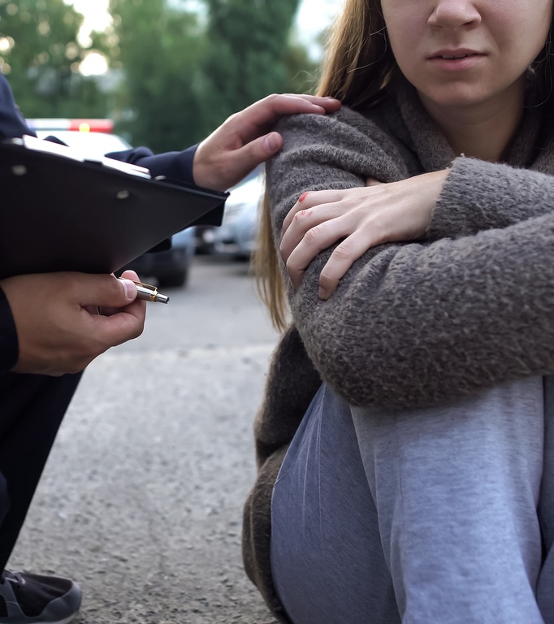
Steps to Developing Rapid Rapport
Go to person’s eye level or below
Once lucid, ask permission before entering their personal space
Ask and use the patient's name
Ask the patient what pronouns they use
Lead in slow deep breathing for someone who is anxious
Unless agitated, join person’s verbal tone and pace
Notes:
Building a relationship with the patient starts with body language and using these techniques to help the patient feel comfortable talking to you
We know that people who are revived using Narcan often have a strong emotional reaction after waking up – we want to help the patient calm down if they are in that state
Don’t stand over the patient – ask if you can come near them and get down to their eye level so they don’t feel intimated by you
Be patient and wait for the patient to become oriented
Use gender neutral terms and/or ask the patient what pronouns they use. This will help the patient feel more comfortable with you and show that you respect them as a person
If the person has a strong emotional reaction, you can do the slow deep breathing exercise we did at the beginning of the training
Join the person in their verbal tone and pace so they feel comfortable talking to you

Slide 53
Sympathy vs. Empathy Video As you watch this video, look for examples of how the characters develop rapport!
https://brenebrown.com/videos/rsa-short-empathy/
Notes:
This video explains the difference between sympathy and empathy
As you watch this video, look out for the various rapid rapport techniques we just discussed – we will be discussing after
Instructors: Play the video either from the slide or open this link: https://brenebrown.com/videos/rsa-short-empathy/

Slide 54
Rapid Rapport Discussion
Which animal was most effective in developing rapid rapport and why?
Which rapid rapport techniques did you notice in the video?
Would you change/add anything about how the animal using rapid rapport responded?
Rapid Rapport Techniques
Go to person’s eye level or below
Once lucid, ask permission before entering their personal space
Ask and use their name
Ask the patient what pronouns they use
Lead in slow deep breathing for someone who is anxious
Unless agitated, join person’s verbal tone and pace
Notes:
Interactive Activity: Rapid Rapport Discussion (4-5 minutes)
Lead the group in a brief conversation answering the questions on the slide

Slide 55
What is Motivational Interviewing (MI)?
General approach to facilitate change
Communication style to build rapport
Not based on one scientific theory
Blending of techniques from other theories
Avoids labeling patients
Notes:
Your traditional role in EMS may be to act as a problem solver. Motivational Interviewing may require you to put that hat down for a few minutes, and just listen to the patient
Motivational Interviewing can remind you to listen to the patients’ potential motivations for seeking change and then using those motivations to help them
It is very possible that the patient may not be ready to be connected to resources that day, but using MI helps you plant a seed for if/when the patient is ready
MI recognizes that the patient is the best person to make decisions about their life and they are the only person who can really make a change in their own life
MI can help to influence/encourage progression through the stages of change

Slide 56
MI recognizes that:
The ideas most likely to succeed are those generated by the individual.
Applies principles that emphasize a collaborative relationship
Can help to influence/ encourage progression through the stages of change
Notes:
MI is based on the premise that the ideas most likely to succeed are those generated by the individual. The person will be most successful when they come up with the ideas themself
You are there to help them figure out what motivates them through a collaborative relationship
Keep the stages of behavior change in mind – you are a facilitator trying to plant a seed that will help the patient move from one stage to the next

Slide 57
MI: FOUR GUIDING PRINCIPLES
Express Empathy
Show compassion and
understanding; remember open- ended questions & affirmations can help!
Develop Discrepancy
Help person see the discrepancy between personal values/goals and current behavior
Roll with Resistance
Help guide the process...not force or drag person into treatment. Avoid direct confrontation!
Support Self-Efficacy
Listen for examples of small success. Believe in the ability to change, to support developing confidence
Notes:
There are a couple of core guiding principles that you can use throughout your interactions with patients
Motivational Interviewing: 4 Guiding Principles
Express empathy:
By showing compassion and understanding while actively listening to a patient, you can express empathy to the patient to show that you can provide support for them through a collaborative relationship
Develop discrepancy:
You can help the person see that their personal values/goals do not necessarily align with their current behavior
Be sure to do this in a non-judgmental way by separating the person from their behavior and helping them understand that their behavior of using substances or using them in an unhealthy way may not align with their personal goals/values
Roll with resistance:
Some people have a strong emotional reaction after being woken up with Narcan and you may encounter some resistance from them
Use the skills we have talked about (ex. Deep breathing, rapid rapport techniques, etc.) to help calm that person down
The goal is not to force people into treatment. The goal is to plant a seed so the person knows there are resources available for if/when they are ready
Support self-efficacy:
Pointing out any example of success can be helpful for the patient. Even if the success may seem small to you, it may actually be a big deal to the patient
For example, someone may have stopped using for 3 days. While this may not seem like a big deal to you, that was probably very difficult for the person so you can use that as a way to provide positive reinforcement and promote self efficacy
This will help the person understand that they are capable of change

Slide 58
Motivational Interviewing Techniques
1
2
3
OARS
Open Ended Questions
Affirmations
Reflect
Summarize
Eliciting Change Talk
Generating Commitment
Notes:
Motivational interviewing is a complex skill that can take a long time to master. We are not going to be experts at this by the end of a 4-hour training, but we want to give you some basic MI skills to practice when working with patients
There are 3 MI techniques we will go over today
OARS
Eliciting change talk
Generating commitment
We will start with the acronym OARS

Slide 59
1
2
3
OARS
Eliciting Change Talk
Generating Commitment
 |  |  | SUMMARIZE
 |  | REFLECT
 | AFFIRM
OPEN ENDED QUESTIONS
Notes:
Review the acronym OARS (open ended questions, affirmation, reflections, and summarization)
The goal of OARS is to build a relationship with the patient and to understand what they are going through so you can help them take the next step

Slide 60
Open Ended Questions:
1
OARS
Questions that can NOT be answered with yes or no
Purpose:
Probe widely for information
Uncover the person’s priorities & values
Avoid ‘socially desirable’ responses
Draw people out
Open-Ended questions are the foundation of OARS
 |  |  | SUMMARIZE
 |  | REFLECT
 | AFFIRM
OPEN-ENDED QUESTIONS
Notes:
The O in OARS stands for open-ended questions, which are questions that can NOT be answered with yes or no
Use open ended questions to understand the person’s personal motivations, goals, and reasons for using. Once you have a better understanding of that, you can help the patient figure out what they want to do next

Slide 61
Open Ended Questions Practice
1
OARS
Please pick one of the scenarios below to practice using open-ended questions. Aim to ask your partner 5 questions or probing statements (“tell me about….”) about any of the topics below. Be sure the questions can NOT be answered with a “yes” or “no” response.
Your partner….
….went to a concert last night. Learn all you can about it!
….. is moving to a new town – learn all you can about why they are moving and why to that particular town.
….started a new job in a new field – learn about this change and what prompted it.
…has just returned from vacation. Learn all you can about why they chose that type of vacation and how it went.
Notes:
Interactive Activity: Open Ended Questions (8-10 minutes)
The purpose of this activity is to practice using open ended questions in daily life before using them in the context of talking to patients with SUD
Make groups of 2 people
Each partner should take turns asking open ended questions and answering the questions based on one of the scenarios on the slide

Slide 62
Yes / No vs. Open Ended
Do you want to quit smoking?
What are your thoughts about your smoking?
Do you smoke a lot of pot?
What do you like
about using pot?
Don’t you want to stop using substances?
What are your concerns about stopping using heroin?
Notes:
Now we will try asking open ended questions in the context of talking to patients post-overdose
Instructors: Put the questions on the left box on the screen first and ask a volunteer to rephrase it to be an open ended question. You can do the first one yourself as an example. There are no right or wrong answers, as long as the rephrased question cannot be answered with yes or no.

Slide 63
Yes / No vs. Open Ended
Can you tell me about how your substance use has affected you or those around you?
Have you had problems with substance use before?
Do you want to go
to rehab?
What do you think about the idea of recovery?
Have you been in treatment before?
What might be some of the benefits of treatment?
Notes:
Instructors: Put the questions on the left box on the screen first and ask a volunteer to rephrase it to be an open ended question. You can do the first one yourself as an example. There are no right or wrong answers, as long as the rephrased question cannot be answered with yes or no.

Slide 64
1
OARS
Affirmations
Affirm the person’s struggle, achievements, values and feelings
Emphasize a strength
Notice and appreciate a positive action, even a small one
Notes:
The next part of OARS is Affirmations
Affirmations help the person feel more comfortable talking to you and will likely continue the conversation
Emphasize people’s small successes (ex. Not using substances for a few days, going to a Harm Reduction Center to exchange a syringe, etc.)
Even if the success seems small to you, it may be a big accomplishment for the patient
Helping the patient feel like they accomplished something important will also support their self-efficacy and encourage them to keep trying even after a set back

Slide 65
1
OARS
Examples of Affirmations
“It takes courage to face such difficult challenges.”
“You’ve quit before; That took a lot of strength.”
“I know you didn’t expect to talk to me about today, so I think it’s great that you’re willing to speak with me.”
Notes:
Review examples on the slide
If you can’t think of anything, you can simply thank the patient for talking to you in that moment

Slide 66
1
OARS
Reflect
Communicates that you have listened
Serves as a ‘check’ that you correctly understood what was said
An effective, non-confrontational way to reduce resistance
Expands on the meaning of what was said
Notes:
Reflective listening communicates to the patient that you are listening and that you are trying to understand what they are saying
You can repeat back to them what they said to make sure you understand

Slide 67
1
OARS
Examples of Reflections
“What I’m hearing you saying is…”
“So on the one hand it seems like.. and, yet on the other hand...”
“Let me see if I heard you correctly...”
Notes:
Review examples of reflections

Slide 68
1
OARS
Summarize
“What you’ve said is important, and I want to be sure I have it right…”
“So, what I think I hear you saying is…”
“Is there anything else you’d like to tell
me about this?”
 |  |  | SUMMARIZE
 |  | REFLECT
 | AFFIRM
OPEN-ENDED QUESTIONS
Notes:
The last letter in OARS is Summarization
This helps bring a conclusion to the conversation and will ideally lead to next steps (ex. Giving a patient the phone number to ReachNJ or a Harm Reduction Center, leaving naloxone behind with a patient or loved one, etc.)

Slide 69
Motivational Interviewing Techniques
1
2
3
OARS
Open Ended Questions
Affirmations
Reflect
Summarize
Eliciting Change Talk
Generating Commitment
Notes:
Now we will talk about the second MI technique: eliciting change talk

Slide 70
2
Elicit Change Talk
Eliciting Change Talk
Change talk is the language/words someone uses that can ‘hint’ at and even increase the chances for a positive change.
Notes:
Change talk is the language someone may use that can hint at their potential and willingness to change their behavior
Look out for this type of talk and use it as an opportunity to motivate the person to change

Slide 71
Examples of Change Talk
2
Elicit Change Talk
Recognizes the problem:
“This is getting pretty bad.”
“I guess this has been affecting me more than I realized.”
“I don't know what to do, but something has to change.
Sees the cost of continuing current behavior:
“No one will ever hire me if I keep this up.”
“I’m scared I will overdose again but no one will be there to help me.”
Shows concern:
“I don’t know how I can keep up like this.”
“Sometimes when I've been using, I just can't think or concentrate.”
Considers the possibility of changing:
“Tell me what I would need to do if I went into treatment.”
“I think I could stop using if I decided to.”
Expresses awareness:
“I think my mom must be really mad at me.”
“I feel terrible about how my drinking has hurt my family.”
Identifies the benefits of support:
“I could probably keep my job if I stopped using.”
“I might feel better if I got some help.”
Notes:
Review examples on the slide

Slide 72
How to Elicit Change Talk
2
Elicit Change Talk
After identifying change talk, you can start to build rapport by asking…
"How has your drug use affected you and those around you?”
"What has been the impact of substance use on your job?”
"What are some things you enjoy doing?”
Another opportunity for open ended questions.
You can engage in a way that feels natural to you – the goal is to build a connection & establish a relationship.
Notes:
Change talk increases the chances that your patient will make actual changes.
This is another opportunity to use the open ended questions we practiced earlier
Review examples on slide
You should engage in the way that feels most comfortable to you – give a compliment, make a connection, build rapid rapport, etc.

Slide 73
Developing Discrepancy
2
Elicit Change Talk
Help the person see the discrepancy between present behavior and their desired behaviors or values
Listen carefully to the person’s statements about personal values and connections to community, family, and faith
If the person is showing concern about the effects of their behavior, highlight the difference to heighten awareness and acknowledgment of discrepancy
Notes:
Motivation for change is strengthened when the person sees the discrepancies between their current situation and their hopes for the future
Your role is to help focus the person's attention on how current behavior differs from ideal or desired behavior
Discrepancy is initially highlighted by increasing the person's awareness of the negative personal, familial, or community consequences of a risky behavior and helping them confront the substance use that contributed to the consequences
The patient should be the one to come up with the arguments for change, not the healthcare provider

Slide 74
How to Develop Discrepancy
2
Elicit Change Talk
1. Ask for the ‘Pros’ of the current behavior:
“Tell me about what you enjoy when getting high.”
2. Ask for the ‘Cons’ of the current behavior:
“What worries you about using drugs?”
“How do drugs affect your family life?”
“What might be different in your life if you stopped using?”
Once the person begins to understand how the current behavior conflicts with personal values, amplify and focus on this discordance until they can see this discrepancy and consider a commitment to change.
Notes:
Asking a patient for the pros and cons of their current behavior can be effective in helping them understand the discrepancy between their behavior and their values/goals
Review examples on slide

Slide 75
Motivational Interviewing Techniques
1
2
3
OARS
Open Ended Questions
Affirmations
Reflect
Summarize
Eliciting Change Talk
Generating Commitment
Notes:
The last MI technique is generating commitment

Slide 76
3
Generating Commitment
Generate Commitment
Generating commitment should follow closely after a patient begins to talk about change
Provide support to help implement the effort:
“What would you like to do next?”
“How can we help you?”
“What have you tried before? Why did it work/not work?”
“What is most important to you right now?”
Your role is to support the individual and connect them with the appropriate resources to accomplish their next step
Notes:
The best ideas for next steps come from within the individual (intrinsic, goal-based motivation)
Meet the patient where they are at instead of telling them what to do next
Any type of commitment to a step in the direction of safer drug use/no drug use is a win and make sure the patient knows that
Your role is not to develop a care plan, but to connect the patient with resources that can help them accomplish what they want their next steps to be
Something that seems like a small change to you may be a big win for the patient

Slide 77
R | RESIST telling person what to do: Avoid telling, directing, or convincing the person about the right path to good health
U | UNDERSTAND person’s motivation: Seek to understand their values, needs, abilities, motivations and potential barriers to changing behaviors
L | LISTEN with empathy: Effective listening skills are essential to understand what will motivate the patient, as well as the pros and cons of their situation
E | EMPOWER person: Work with the individual to set achievable goals and to identify techniques to overcome barriers
Notes:
Our last MI acronym is RULE. It summarizes some of the recurring themes throughout this training
Review each letter of the acronym and describe what it stands for

Slide 78
MI: FOUR GUIDING PRINCIPLES
Express Empathy
Develop Discrepancy
Roll with Resistance
Support Self-Efficacy
Notes:
Review the 4 guiding principles of motivational interviewing
Motivational Interviewing: 4 Guiding Principles
Express empathy:
By showing compassion and understanding while actively listening to a patient, you can express empathy to the patient to show that you can provide support for them through a collaborative relationship
Develop discrepancy:
You can help the person see that their personal values/goals do not necessarily align with their current behavior
Be sure to do this in a non-judgmental way by separating the person from their behavior and helping them understand that their behavior of using substances or using them in an unhealthy way may not align with their personal goals/values
Roll with resistance:
Some people have a strong emotional reaction after being woken up with Narcan and you may encounter some resistance from them
Use the skills we have talked about (ex. Deep breathing, rapid rapport techniques, etc.) to help calm that person down
The goal is not to force people into treatment. The goal is to plant a seed so the person knows there are resources available for if/when they are ready
Support self-efficacy:
Pointing out any example of success can be helpful for the patient. Even if the success may seem small to you, it may actually be a big deal to the patient
For example, someone may have stopped using for 3 days. While this may not seem like a big deal to you, that was probably very difficult for the person so you can use that as a way to provide positive reinforcement and promote self efficacy
This will help the person understand that they are capable of change

Slide 79
Notes:
Prepare for Role Playing exercise

Slide 80
Motivational Interviewing Role Playing Scenarios
14-year-old overdosed teenager at home
A call comes in from Central Dispatch that a suburban middle class neighborhood at 10 pm, regarding a 14-year-old female who was found by her parents in an upstairs bathroom. She was found by her parents unconscious on the bathroom floor. The parents were directed by Dispatch to begin CPR. The parents are in their mid 50s and have very limited knowledge of drug use.
Upon your arrival you notice some glassine packets on the floor behind the toilet containing what appears to be Oxycontin. The parents do not recognize their daughter has overdosed. In talking to the parents they are shocked to hear their daughter has been using drugs, and have no knowledge of any prior use and are in denial of her use. She is reversed from the overdose and immediately begins sobbing. The parents are supportive but in denial.
2. Mother overdoses with three children at home
You are contacted by Central Dispatch to respond to a residential address where a nine year old child called 911 reporting his mother won’t wake up. Upon arrival at the home you go to the kitchen and find the police present, having reversed the mother from an apparent Opiate (suspected fentanyl ) overdose. She appears more embarrassed then angry or fearful, as you begin to interact with her.
You are told there are three children in the home, ages nine, seven and four. The father (35 yrs) and mother (29 yrs) are separated, with the father living with his parents approximately 5 miles away. From her reaction, you believe this mother may have been reversed before.
3. Pregnant Single Women overdoses in library rest room
You receive a call that a young woman has been found in the stall of a library restroom on the floor and unconscious. Central Dispatch said the caller hung up before they could get any further information. You are near library so arrive approximate two minutes from receiving the call. You enter the restroom and find the young Woman, pregnant (approx. 5 months) on the floor. Her breathing is shallow and guttural, and her lips and fingertips are blue.
4. Middle-aged man unresponsive in local diner restroom
You have arrived at about 9:00pm with your fellow responders to find a man, approximately 50 years of age, in the men’s room of a local diner, unconscious. He was found by the owner of the diner, who says he has never see the man there before. He appears to be homeless, as there is a larger cart of belongings near him, and there is a syringe lying next to him.
Notes:
Interactive Activity: Role Playing (30-60 minutes, depending on how much time you have left)
Break the class into groups of 3-5 people
Encourage people to get up and meet new people for this exercise
If you have a group with mixed backgrounds, make sure at least 1 person from EMS or another first responder is in each group)
Tell the students that they can pick one of the scenarios on the slide (or the instructor can assign each group a scenario) and they should practice role playing it like the instructors just did
Assign roles to each member of the group
1 patient
1-2 first responders
1-2 observers
Another role if necessary for the specific scenario (ex. Parent, bystander)
At the end of the scenario, discuss any feedback (positive and constructive) that the group has for each other – there is always room for improvement
If the group finishes early, they can try doing the exercise again but switching up the roles or try a different scenario on the slide
Instructors: If possible, assign 1 instructor to each group or if there are not enough instructors for each group, walk around to make sure each group is on the right track
ALTERNATE APPROACH:
Break class into groups and assign role plays
Let them review for 10 minutes or so, and then ask for volunteer group to go first, and do role play in front of full class.
THIS ALLOWS for all to observe and learn from each other.
IMPORTANT: YOU ARE STILL facilitating the process!!
1-Check in with 'the patient' to see how they felt in the process;
2 – Check in with the "EMT"
AND THEN GO TO GROUP for 'Positive feedback' -- then ideas to improve – and finish with more positive

Slide 81
Role Playing Discussion Questions
Which parts of this felt comfortable for you? What felt uncomfortable?
How is this similar or different than how you typically interact with a patient post-overdose?
What skills from the training did your group use?
What feedback did you give your group members?
Notes:
Interactive Activity: Discussion about Role Playing (10-15 minutes)
When you come back together as a group after the role playing, start a discussion about how the activity went

Slide 82
“If you didn’t offer me treatment when I didn’t want it, I wouldn’t be here to take the treatment when I was ready.”
Notes:
We started the training with this quote and we just want to remind you of it at the end of today’s training
Our goal is to apply the communication techniques you learned today out in the field to connect with patients and to encourage them to get help when they are ready

Slide 83
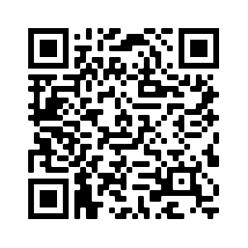
Contact Information
Evaluation
INSTRUCTOR NAME EMAIL
INSTRUCTOR NAME
EMAIL
Five Minutes to Help
5MinToHelp@doh.nj.gov
https://rutgers.ca1.qualtrics.com/jfe/form/SV_cGEYlvY6XnCidZX
Notes:
Participants MUST fill out the evaluation to receive 4 CEUs
Instructors:
Make sure you edit this slide to include all of the instructors’ names and contact information (email, phone, etc.)
If you would like to receive a copy of the evaluation results from your class, please email 5MinToHelp@doh.nj.gov
You can direct people to the 5MinToHelp@doh.nj.gov email address if they have feedback or questions about Five Minutes to Help or want more information about naloxone leave behind
After your class, please email 5MinToHelp@doh.nj.gov the number of people who attended your class and any feedback/comments you have

