Slide 1
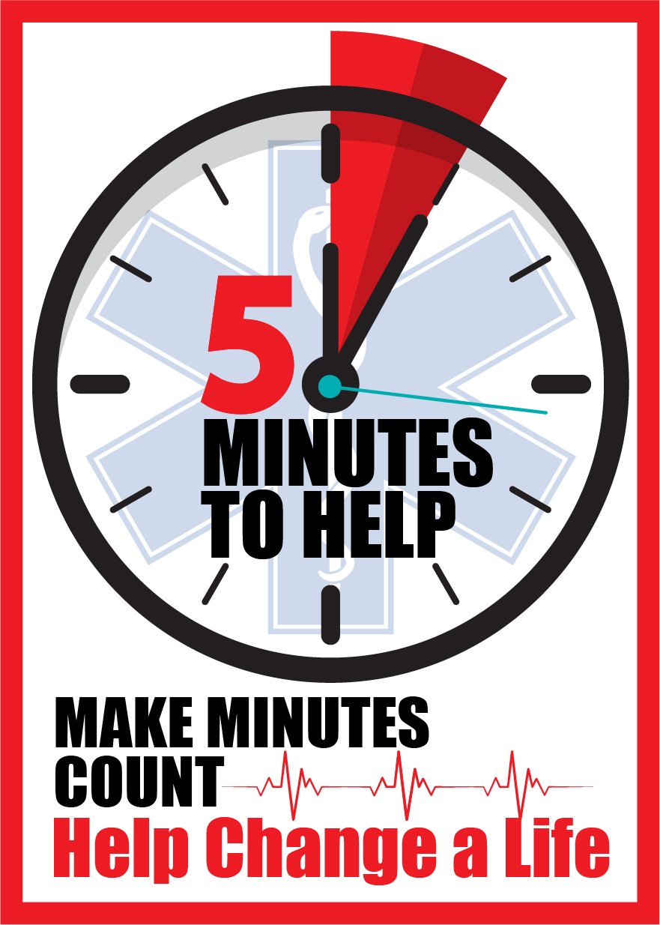


Five Minutes to Help
June 2026
Notes:
The purpose of today’s training is to help first responders develop new knowledge and communication skills that can be applied on the scene, post-overdose reversal, to encourage Substance Use Disorder (SUD) patients to seek help for their addiction and make them aware of available resources
Five Minutes to Help was envisioned by the NJ Department of Health’s Office of Emergency Medical Services, and the content in today’s training was developed by the Rutgers School of Public Health, with funding from the NJ Department of Health
This is a four-hour session, and 4 EMS CEUs will be issued upon completion of your evaluation; we will provide the link to the online evaluation at the end of the training
Some of the content in this training may be sensitive for some people. If you ever feel triggered or upset, feel free to step out of the room for a few minutes to reset.

Slide 2
Why are we here?
Up to 20% of individuals who EMS providers administer Narcan to refuse transport to a hospital or leave the ER before being seen by a healthcare provider.
First responders are often the only healthcare professionals to interact with those patients.
Notes:
EMS data shows that up to 20% of individuals who EMS providers administer Narcan to refuse transport to the hospital or leave the Emergency Room before being seen by a healthcare provider. However, this percentage is likely significantly higher due to several identified factors, such as public access to free naloxone, poly-substance overdose, data, and other reporting limitations.
This puts EMS providers in a unique position because it means that they are the only healthcare professional the patient will interact with that day
As a first responder, you can encourage those patients to seek help and provide resources for them. This class will give you skills to be able to do that

Slide 3
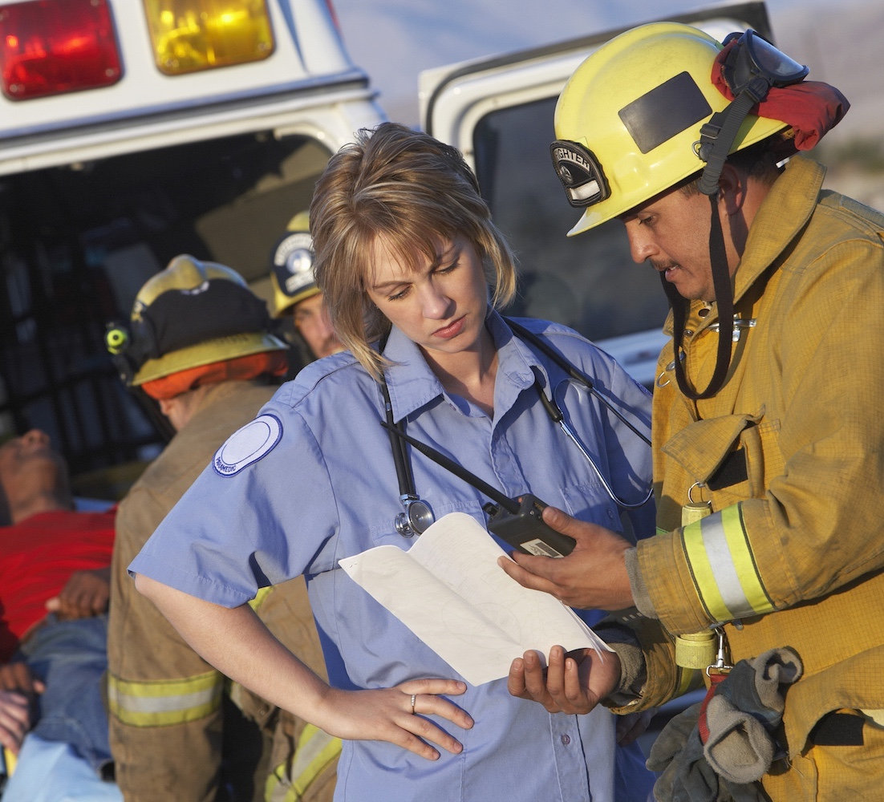
Goal of Five Minutes to Help
To provide first responders with new skills in
motivational interviewing
and other communication techniques to apply
after revival from an opioid overdose.
Notes:
The goal of today’s training is to train first responders and other public health professionals in basic Motivational Interviewing and other communication techniques to apply after reviving a patient from an overdose
That being said, we understand what it’s like when an individual has been revived with Narcan – they may be experiencing a range of emotions and may not be willing or even able to hear what you are saying. We realize that you may only have successes with a select number of patients, but this class will teach you how to plant a seed with some patients so they will know that there is help available if/when they are ready
This country needs a new approach for addressing the opioid epidemic and this class is one way that we can do our part to help

Slide 4
Objectives
After the training, participants will be able to:
  Describe the stigma & stereotypes associated with substance use.
  Identify several approaches for addiction treatment and harm reduction.
  Explain the stages of behavior change.
  Demonstrate basic motivational interviewing techniques as a communication tool.
Notes:
Review key objectives
Our objectives are NOT to put every patient into substance use treatment or to turn you into a therapist from this 4-hour training
Throughout this training, we want to hear about your experiences from interactions with patients
We are not asking you to spend hours with patients to get them to go to treatment
You are not going to be a therapist or addiction counselor by the end of this training
We are asking you to spend about 5 minutes to talk with your patients with empathy about their options to get help (that's why this training is called Five Minutes to Help)
We are also asking that you learn about the resources available in the state and in your communities so you can tell your patients about the support that is available for them
The purpose of this training is to give you more skills in your toolbox to help your patients and communities

Slide 5

“If you didn’t offer me treatment when
I didn’t want it, I wouldn’t be here to take the treatment when I was ready.”
Notes:
This is a real quote from someone receiving treatment for an opioid addiction
While of course not every person who uses substances will be responsive every time, some will be ready
Your job is to make sure the patients who are not ready know that help is available if/when they want it and to connect patients who are ready for help to recovery resources
Our goal as we go through today’s training, and as you apply the communication techniques out in the field, is to try to connect with patients and to encourage them to get help if/when they are ready
ONE IDEA: Have someone from the class read this statement out loud – and then an instructor can read the letter
Instructors: you may read the letter form an individual in recovery out loud or give it to participants as a handout and encourage them to read it during a break. The letter is available on the instructor website.

Slide 6

Important Note:
If there is an indicator of intentional
overdose/suicide, first responders must
follow standard protocols.
Notes:
I THINK WE COULD REMOVE THIS?
If an overdose patient is showing signs of intentional overdose (ex. Suicide attempt), please follow the proper protocol for transporting that patient to the hospital

Slide 7
Section 1
Compassion Fatigue

Slide 8
Discussion about
Successes & Frustrations
What successes have you experienced during an overdose call?
Notes:
Interactive Activity: Discussion about Successes (5-7 minutes)
Ask:
How many people in the room have treated an overdose patient before?
Based on your experiences treating overdose patients, what are some of the successes you have experienced with overdose reversal?
Remember that successes can be small – even if it doesn't feel like a big deal to you as a first responder, it may be a big success for the patient
Some examples of successes include:
Patient went to the hospital
Connected patient with a recovery resource
Patient survived
Left Narcan or other resources behind with a patient, friend, or family member
Had a conversation with a patient about their substance use

Slide 9
Discussion about
Successes & Frustrations
What frustrations have you experienced during an overdose call?
Notes:
Interactive Activity: Discussion about Successes (5-7 minutes)
Ask:
How many people in the room have treated an overdose patient before?
Based on your experiences treating overdose patients, what are some of the successes you have experienced with overdose reversal?
Remember that successes can be small – even if it doesn't feel like a big deal to you as a first responder, it may be a big success for the patient
Some examples of successes include:
Patient went to the hospital
Connected patient with a recovery resource
Patient survived
Left Narcan or other resources behind with a patient, friend, or family member
Had a conversation with a patient about their substance use

Slide 10
Compassion Fatigue
Mental stress resulting from exposure to other people’s traumatic events, which negatively impacts first responders’ mental/physical health and general wellbeing.
Depression
Anxiety
Irritability
Dissatisfaction with work
Post Traumatic Stress Disorder (PTSD)
Feeling of Moral Injury
Exhaustion
www.ncbi.nlm.nih.gov/pmc/articles/PMC4924075/
www.ems1.com/public-health/articles/compassion-fatigue-the-hidden-danger-of-concurrent-national-public-health-emergencies-iql86uQ0tRIIDt1N/
Notes:
Compassion fatigue is very common among first responders, and it is okay if you are experiencing it – you are not alone
Secondary stress from treating trauma again and again in addition to burnout can lead to compassion fatigue
The definition of compassion fatigue is mental stress that results from exposure to other people’s traumatic events, which can negatively impact your mental or physical health and wellbeing
Some of the signs and symptoms include depression, anxiety, irritability, PTSD, feeling of moral injury (overwhelmed by situation because of limited resources and support) and exhaustion

Slide 11

Notes:
Acknowledge that compassion fatigue is discussed in the one- hour training, along with the concept of Moral Injury … and that is very easy to understand why it can occur … so for now, lets just take a couple minutes to center ourselves, be present for today's training.
Can be applied in the field for patients, families, etc. - maybe video – Department Human Services
Interactive Activity: Breathing Exercise (2 minutes) (optional)
Instructors: you may decide if you would like to facilitate this activity or not
First responders experience a lot of stress during their jobs, but there are simple things you can do to help with that, such as taking a moment to practice deep breathing
Let’s take a few minutes to get centered with deep breaths
Invite the group to place both feet flat on the ground and close their eyes
Release the tension in your shoulders, loosen your jaw
Lead group through a few slow deep breaths. Breathe in for 4 seconds, hold for 4 seconds, and breathe out for 4 seconds. Repeat 3-4 times
After doing this a few times, ask the participants to slowly open their eyes
You can always use this technique if you feel overwhelmed with a situation. It is a quick exercise, but is proven to be really helpful in stressful moments
Hopefully you now feel more centered and are ready to learn!

Slide 12
Section 2
Substance Use Disorder & Harm Reduction

Slide 13








Risk Factors of SUD
Genetic predisposition for an addiction
Social pressures
Family history of SUD
Co-occurring conditions
Use of drugs early in life
Inadequate chronic pain management
Environmental
influences
Notes:
INTERACTIVE ACTIVITY: 5 MINUTES
You saw in the online training that Substance Use Disorder is really a chronic disease of the brain....and there are/can be a lot of risk factors or causes, like those you see here. This is not an exhaustive list.
One discussion option: Which of these risk factors do you think is the most significant in contributing to substance use disorder?
Gather response from students, but be sure to note that any of these can be a risk factor and each individual is different. I.e. different personalities, different circumstances, and different risk factors in their life.
Again, this list is not fully complete, but the purpose of this slide is to explain that there are many causes of SUD. Any one or a combination of these factors can lead to addiction and these examples show that it is not someone’s choice.
Discuss some of the following risk factors:
Genetic predisposition – scientific studies show that addiction can be a hereditary disease because there is a gene that can make people more susceptible to becoming addicted to substances
Family history – living in a home where a parent, sibling, or other family member uses substances can lead someone to develop SUD
Use of drugs early on in life – when someone starts using substances at a young age, they are more likely to develop a SUD throughout their lifetime
Environmental influences – our environment plays a big role in our health – even our zip code can be the biggest indicator of our health status
For example, living in a community in which there is easy access to drugs can lead a person to start using and develop SUD
Social pressures – we know that peer pressure, especially among adolescents, can lead people to start using
Co-occurring conditions – individuals may use substances in an effort to self medicate for their mental health issues (ex. Depression, anxiety, PTSD)
Inadequate chronic pain management – in some cases, people who are injured are prescribed opioids for the pain, but get addicted and then turn to other drugs (ex. Heroin) when their prescription runs out.

Slide 14
SUD Treatment Can Help Someone…
Stop using drugs
Reduce the frequency of drug use
Reduce the risk of harm from using drugs
Be productive in the family, at work, and in society
Notes:
For some people, recovering from a substance use disorder may feel impossible, but there are many people in the world who have done it – you may even know someone who has successfully stopped using drugs or reduced frequency of using
Although treatment and recovery is possible, we need to recognize that there is not a one size fits all approach for this. Every single person who uses drugs has a different pathway that works best for them
It is also important to recognize that not everyone’s goal is to stop using drugs entirely. Some people simply want to stay safe while they are using drugs or use drugs while still being a productive member of society
Reducing stigma surrounding SUD means accepting that not everyone has the same journey

Slide 15
Medications for Opioid Use Disorder
Purpose: Curb cravings too prevent the use of opioids
Benefits of MOUD
What is MOUD?
Types of MOUD
Reduce opioid use and symptoms related to OUD
Reduce the risk of an overdose related death
Support people who choose to reduce or stop the use of opioids
Decrease the risk of infectious disease transmission
MOUD is an evidence-based intervention that is proven to be effective in treating Opioid Use Disorder (OUD)
Buprenorphine
Methadone
Naltrexone
Suboxone (Buprenorphine + naloxone)
National Harm Reduction Coalition
FDA: Information About MOUD
Notes:
The 1-hour training discusses in detail the medications for opioid use disorder. Lets briefly revisit these medications.
MOUD is an evidence-based intervention that is proven to be effective in treating Opioid Use Disorder (OUD)
Benefits of MOUD:
MOUD supports people who are ready to reduce or stop the use of opioids
It increases the likelihood that someone will not continue use of substances and remain in recovery
Reduces opioid use and associated symptoms
Decreases the spread of infectious diseases that can be spread through sharing needles because they are not using substances
MOUD has the potential to prevent an overdose related death

Slide 16
Harm Reduction
A set of practical strategies and ideas aimed at reducing negative consequences associated with drug use and preventing overdose deaths.
A movement for social justice built on a belief in, and respect for, the rights and autonomy of people who use drugs.
Evidence-based and effective in reducing overdoses and overdose deaths.
  The intent is to reduce the risks associated with drug use.
  The purpose is NOT to force people to stop using drugs.
  The purpose is to keep people alive long enough for if/when they are ready to stop using.
Notes:
Besides treatment to help people stop using drugs entirely, there are other ways that we can help people living with SUD
The purpose of harm reduction is intended to meet people where they are at. It is an evidence-based intervention rooted in social justice
Harm reduction can also be applied to help people living with SUD use substances in a safer way
The purpose of harm reduction is NOT to force people to stop using drugs entirely. The purpose is to keep people alive long enough for if/when they are ready to stop using substances
Studies show that harm reduction reduces overdoses and overdose deaths, and it does NOT encourage people to use drugs
Everyone uses harm reduction in their daily lives
Seat belts - riding in a car can be dangerous, but we wear seat belts to minimize the risk of harm if we get into an accident
Helmets - riding a bike is also dangerous, but we ensure that ourselves and our children wear helmets to provide protection if we fall
Condoms, vaccines, masks, designated drivers, etc.
Harm reduction has always been used in public health, but the concept was first identified during the HIV/AIDS epidemic in the 1980s when activists found ways to reduce the spread of HIV

Slide 17






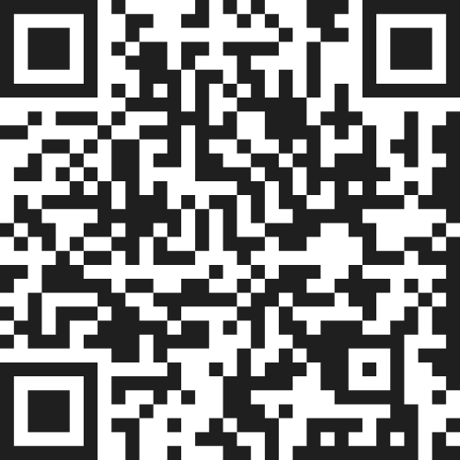


Examples of Harm Reduction
Overdose education & access to naloxone
On-site counseling & referral to social services
Harm Reduction Health Nurses
There are Harm Reduction Centers in all 21 counties in NJ.
Safer smoking/sniffing supplies, sterile syringes, needles & injection equipment, & testing strips
Condom Distribution & safe sex education
SUD treatment and mental health care services
HIV & Hep C Testing / counseling / PrEP
Notes:
Note: In an effort to connect EMS/first responders with local harm reduction agencies, we have been inviting representatives to speak for ~10 minutes about the specific resources they offer. The NJDOH 5 Min to Help outreach coordinator can assist with this, or if you have a contact at your community's harm reduction center, feel free to invite them as well!
Harm Reduction Centers (HRCs) are community-based programs that provide a safe, trauma-informed, non-stigmatizing space for people who use drugs to access resources.
It is important to note that NJ is a state that is comitted to harm reduction services as an effective treatment for people with susbtance use disorder.
Most HRCs have integrated health care with SUD treatment and mental health care onsite.
There are either stationery and/or mobile Harm Reduction Centers in all 21 counties in NJ.
You should familiarize yourself with the resources that are available in your community/county so you can refer patients to them
Here are some examples of harm reduction and we will go into more detail on how they help on the next few slides
The NJ Department of Health is continuing to approve additional Harm Reduction Centers, so keep an eye out for more information about new ones opening near you.

Slide 18
Section 3
Stigma Surrounding Substance Use Disorder

Slide 19
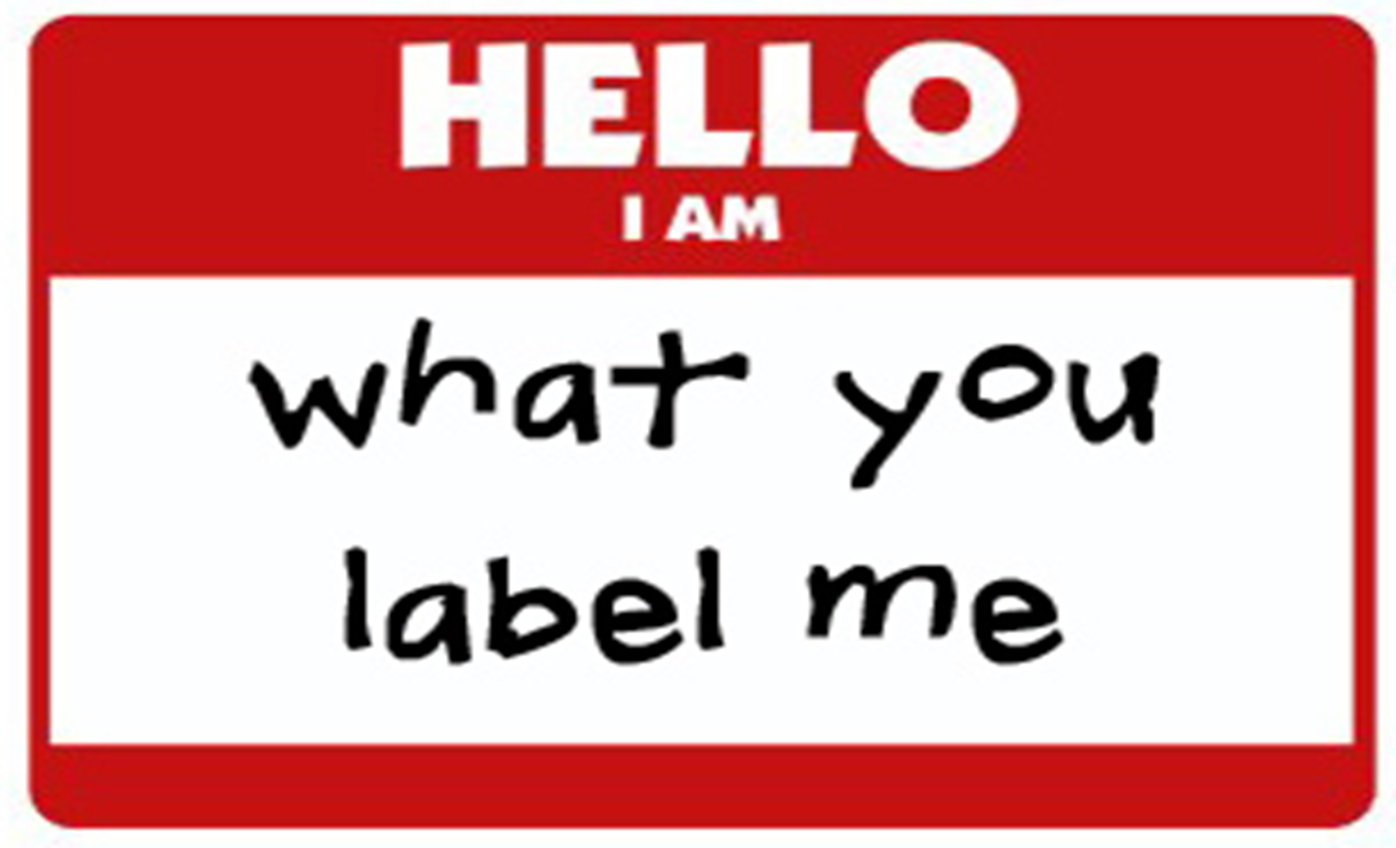
Notes:
INTERACTIVE ACTIVITY: 5-7 MINUTES
The purpose of this activity is to provide a space for students to acknowledge their biases, and then figure out how to move past them to help our patients
Before starting the activity, explain to the students that this is a safe space and anything they say will be kept in the room
Ask: What are some characteristics you have used or heard other people use to describe EMS/First Responders/Healthcare Workers?
If you are teaching an in person class, you can ask a volunteer to write down the answers on a white board if available
If you are teaching an online class, you can ask people to unmute and/or put their answers in the chat box
Note: we are not validating their answers, we are just asking them to think about the characteristics they think of or heard when describing this group.
Ask: What are some characteristics you have used or heard other people use to describe people with substance use disorder/addiction?
Give the students time to answer, but some responses may include: addict, junkie, frequent flyer, user, helpless, burden, etc.
If you are teaching an in person class, you can ask a volunteer to write down the answers on a white board if available
If you are teaching an online class, you can ask people to unmute and/or put their answers in the chat box
You may see that there are more negative characteristics listed for people with SUD – often because of the stigma associated with SUD and the percieved negative traits of the individual.
Then, ask the group to summarize each list and ask them to describe what they are seeing.
Are the characteristics positive or negative? Neutral?
What are some differences between the two groups?
What are some similarities?
Then, ask: Think back to someone you know, or someone you encountered or treated that is in recovery.
Do those characteristics still apply to that person? Are there new characteristics that you might think of?
Did they always have those characteristics or are they new characteristics they developed?
After you have received some responses, ask the students to use some empathy to reframe the way they think about people who use substances. All of these words are not necessarily true for every person who uses substances.
Ask: What are some more positive words that we can use to describe people who use substances or are in recovery if we have some empathy for them? What about someone you know who has used or is using substances?
Give the students time to answer, but some responses may include: resilient, resourceful, someone’s family member/friend, lonely, hard worker, etc.
Use Chat Box or white board to track responses
These are sterotypes, unconscious bias – think of how easily did you identify those characertistics, these are embedded as sterotypes and unconscious bias.

Slide 20
Individuals living with Addiction Need Support,
Not Stigma
Some of the characteristics in the list we created can be dismissive and dehumanizing
Stigma can be a barrier for individuals to access care and support
Language should take the focus off of the individual’s disease, and allows us to see them as a person – not a moral failing
AMA Task Force to Reduce Opioid Abuse
Notes:
Thank the participants for openly discussing the terms that we may use and the people around us may use to describe people living with substance use disorder
Using language like this is dehumanizing and studies show that the stigma that is perpetuated from negative language can hinder people’s ability and willingness to access SUD treatment
language should take the focus off of the individual’s disease, and allows us to see them as a person – it is not a moral failing

Slide 21
Section 4
Resources

Slide 22

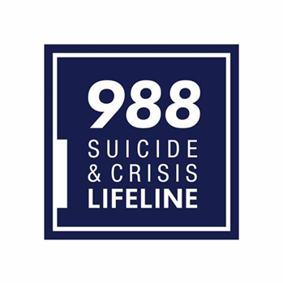

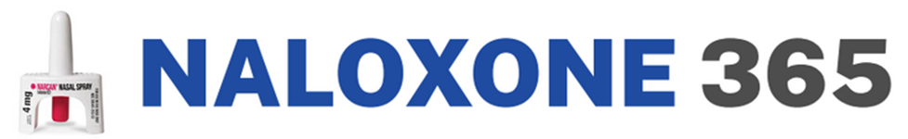
Resource | Description
 | ReachNJ is the state’s 24/7 addiction hotline that you can call with a patient to find out about nearby resources that fit the patient’s needs. Anyone can call ReachNJ regardless of insurance status or ability to pay.
 | The 988 suicide and crisis lifeline is a national hotline that anyone can call if they are in crisis. Whether someone is facing mental health struggles, emotional distress, alcohol or drug use concerns, or just needs someone to talk to, their counselors are available.
 | SafeSpot is a free, 24/7, national hotline that is staffed by a dedicated team of people with lived and living experience with overdose and drug use.
 | Pharmacies acquire naloxone through their normal network of medication distributors and after dispensing, bill the state utilizing a special NJMMIS/Medicaid billing code to receive reimbursement at the current Medicaid rate. Website: Stopoverdoses.nj.gov
Notes:
Every person treating overdose patients should learn about the resources available in their community, county, and state.
Here are a few that you can learn about
ReachNJ is the state’s 24/7 addiction hotline that you can call with a patient to find out about nearby resources that fit the patient’s needs. Anyone can call ReachNJ regardless of insurance status or ability to pay
The 988 suicide and crisis lifeline is a national hotline that anyone can call if they are in crisis
Naloxone 365: Pharmacies acquire naloxone through their normal network of medication distributors and after dispensing, bill the state utilizing a special NJMMIS/Medicaid billing code to receive reimbursement at the current Medicaid rate. Stopoverdoses.nj.gov
Instructors – feel free to add local resources to this slide too

Slide 23
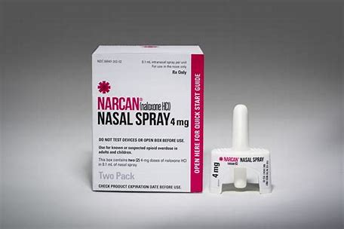
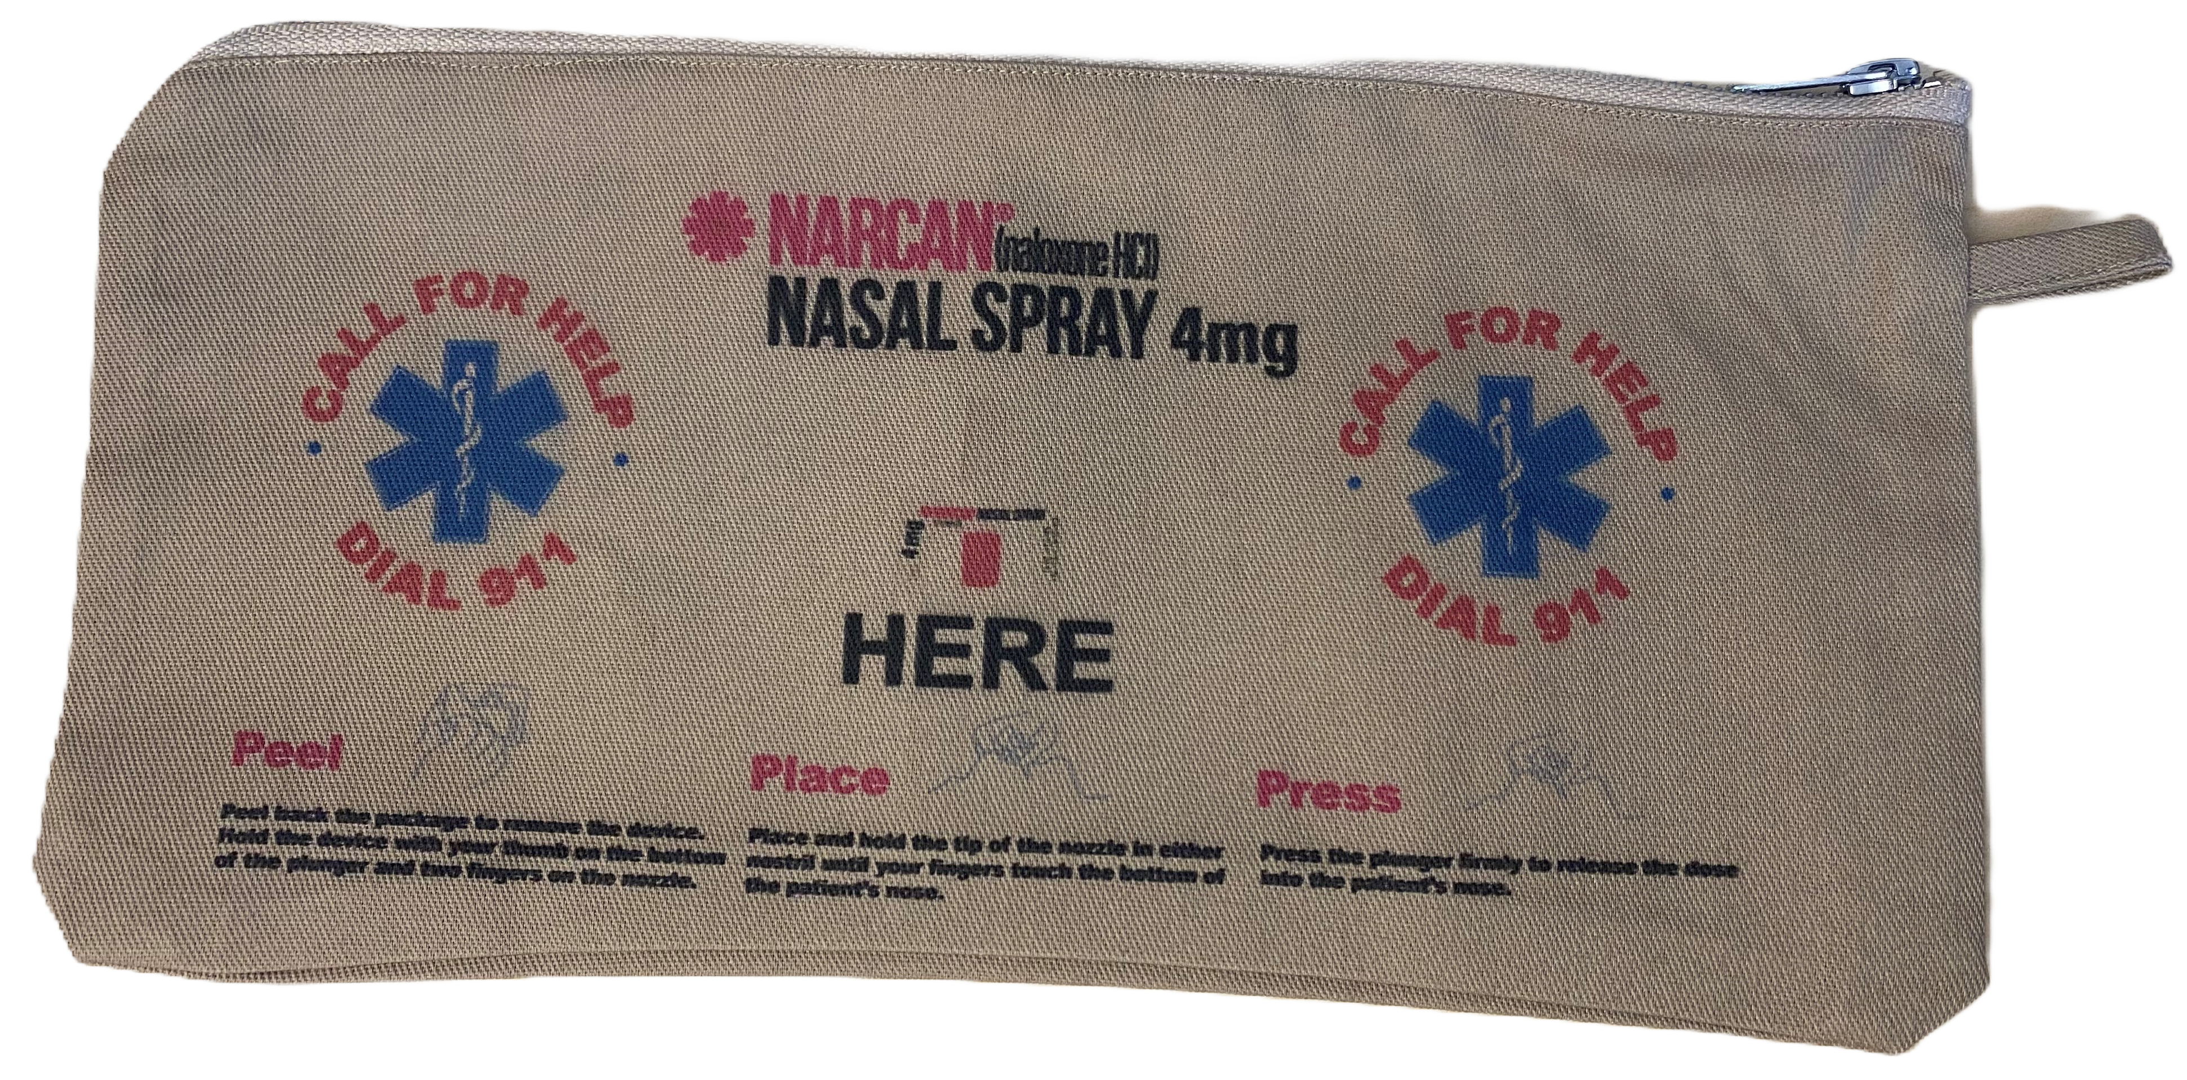
Naloxone Leave Behind
First responders must offer to leave naloxone and resources behind with a patient, friend, or family member post-overdose if the patient refuses transport to the hospital
Resources must include information about
  Recovery
  Treatment
  Harm reduction
Passed in 2021 in NJ
Email 5MinToHelp@doh.nj.gov to receive FREE naloxone and resources.
Notes:
Requires all first responders (EMS, fire, and law enforcement) to offer to leave naloxone and recovery/harm reduction resources behind with a patient who refuses transport to the hospital after an overdose (or with a friend, family member, or bystander)
This is an example of harm reduction because it increases access to naloxone in the community in the event of an overdose
Naloxone Leave Behind law was passed in 2021 in NJ
Your agency can request to receive FREE naloxone and resources – email 5MinToHelp@doh.nj.gov.

Slide 24
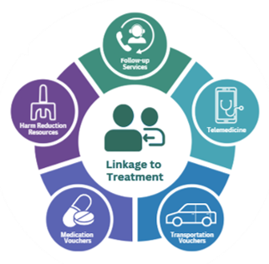
why What we do… matters
Efficiently links individuals with opioid use disorder to medication-assisted treatment (MAT) programs
24/7, 365 days a year.
Supports patient success through various other resources, including overdose prevention and direct patient follow-up. ​
Notes:
The New Jersey Department of Health has recently partnered with MATTERS, a Rapid Referral Platform, to help address barriers to treatment, such as stigma, transportation to appointments, and medication costs.
MATTERS is designed to connect individuals struggling with opioid use to addiction treatment medication 24/7. It provides vouchers to cover the cost of their medication and allows for up to three round trips to appointments, pharmacies, their homes, etc.
Additionally, the platform includes a telemedicine option for individuals who cannot secure a same-day appointment and needs immediate access to medication.
The Outreach Coordinator at the New Jersey Department of Health offers follow-up services at intervals of 72 hours, 30 days, 60 days, and 90 days after initial contact to ensure individuals can access services and address any barriers they may encounter.

Slide 25
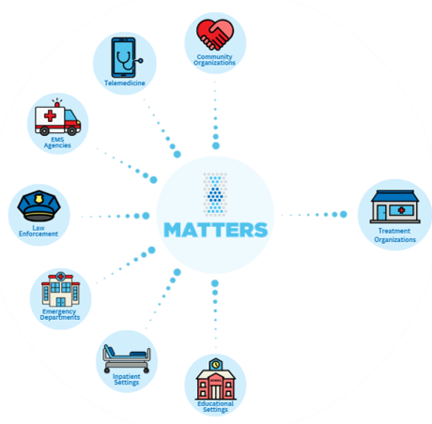
why What we do… matters
Collaborative Partners:
First Responders
Corrections/Courts
Hospitals
Community Organizations
Importance of EMS:
Post-Overdose Fear
Trusted Source
Only Healthcare Clinician They May Encounter
One Patient at a Time
Long Wait Times / AMA
Meet Them Where They Are
Trajectory of Care
Notes:
Any interested organization can be a referring partner to the treatment organizations in the platform. This can include EMS, law enforcement, hospitals, community organizations, and educational settings.
Oftentimes, EMS providers are the only health care professionals that patients encounter post-overdose.
Patients may choose not to be transported to the hospital because of negative past experiences, or they may leave the hospital due to long wait times or the stigma associated with seeking help.
This leaves EMS in a unique position to make a positive impact on the trajectory of patient care, making this platform an important resource for linking patients to care effectively.

Slide 26


Slide 27
Section 5
Behavior Change

Slide 28
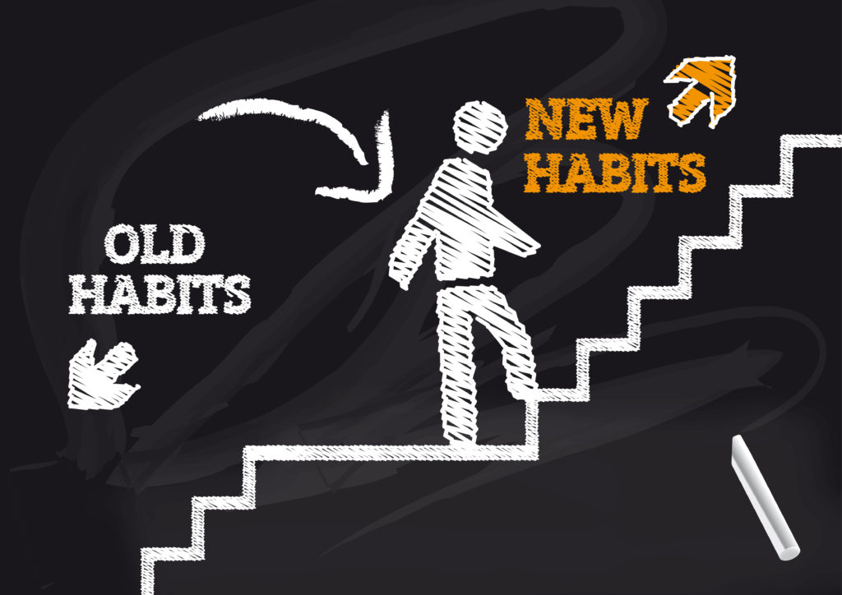
Notes:
Now we are going to talk about the process of behavior change
We have all tried to change a habit/behavior and this is no different from someone trying to stop using substances or trying to use them in a safer way

Slide 29
Behavior Change
Discussion Questions
What behavior/habit have you tried to change in your life?
What barriers/challenges did you experience?
Were you successful in changing behavior? Why or why not?
Notes:
Interactive Activity: Changing Habits (10-12 minutes)
The goal of this activity is to help people understand that everyone has tried to change a behavior at some point in their life and this is no different than someone trying to stop using substances or use substances in a safer way – we have all experienced this, struggled with this, and been successful with changing something in our lives
Instructors – you can choose to facilitate this exercise as a group or break up into groups of 2-3 people. If you have enough time, you can come back together as a group to discuss what people talked about in their smaller groups.
Ask participants to answer each question on the slide one at a time.
Some examples of behavior change are:
Losing weight
Quitting smoking
Stopping biting your nails
Less procrastination
Starting to exercise
Eating healthy
Changing jobs
Feel free to come up with your own examples from your life too and open it up for some people in the class to respond
Do NOT list the behaviors above without giving everyone a chance to answer, but if there is silence after you ask the question, you can give 1-2 of the examples above to get the conversation started
Changing a behavior can be taking something negative out of your life (ex. Losing weight) AND/OR adding something positive into your life (ex. Starting to exercise). Reframing behavior change in a positive way is important for this activity.

Slide 30


Dedicated to all the people who are weary….
….of trying to educate, advise, entice, convince, coax, cajole, persuade, sweet-­talk, smooth-­talk, guilt-­trip, bribe, manipulate, or otherwise get people to change.
Notes:
Ask a volunteer from the class to read this quote
The purpose of sharing this quote is to help everyone understand that forcing someone to change doesn’t usually work. Change must come from within, so we need to meet people where they are at

Slide 31
Stages of Behavior Change
Pre-Contemplation
(“I don’t have a problem”)
Contemplation
(“Maybe this is something I should consider?”)
Re-Occurrence
of Use (triggers, over-confidence)
Termination /
Ongoing Recovery
Maintenance
(“I’m feeling pretty good about what I’ve done!”)
Preparation
(“What do I need to do?” or “What will I need?”)
Action
(“Let’s Do it!”)
Notes:
The purpose of this slide is:
To understand the stages of behavior change
To be able to identify where people are in the stages of behavior change to help them move to the next stage
Participants do NOT need to necessarily memorize the stages of change, but the point is to understand that we all have stages that we go through to change so we can meet patients where they are instead of pushing them to do something they aren’t ready to do yet
Stages of behavior change:
Precontemplation:
People in this stage are not thinking seriously about changing and may not see their drug use/SUD as a problem
In their perspective, the pros of using probably outweigh the cons of using, which is why they continue the current behavior
Contemplation:
People in this stage may be considering the possibility of quitting or reducing substance use but feel ambivalent about taking the next step
Despite the pros of using, they are starting to experience some adverse consequences (which may include personal, psychological, physical, legal, social, or family problems)
Preparation:
They probably see that the cons of continuing to use may outweigh the pros and they are less ambivalent about taking the next step
People have usually made a recent attempt to change using behavior in the last year
They are usually taking some steps towards changing behavior. They believe that change is necessary and that the time for change is imminent
Action:
People in this stage are actively involved in taking steps to change their behavior. They may be in recovery/have not used substances for some period of time
Maintenance:
People have been in recovery and are able to successfully avoid triggers that may lead to using again
They have learned to anticipate and handle temptations to use and are able to employ new ways of coping
Re-Occurence:
During this change process, most people will experience relapse
Relapses can be important for learning and helping the person to become stronger in their resolve to change, but they can also be a trigger for giving up in the quest for change
The key to recovering from a relapse is to review the quit attempt up to that point, identify personal strengths and areas for improvement, and develop a plan to solve similar problems in the future
Remember that relapse is a common occurrence for many chronic illnesses (ex. Diabetes, asthma) like we talked about at the beginning of the training
Termination/ongoing recovery
Recovery is possible! Many people living with SUD will fully recover from using substances and can live long, healthy lives.
Instructors: When you are going through the stages, feel free to give examples from your own life for each stage or use an example that someone gave during the discussion about types of behavior change. Using a common example before explaining how this relates to SUD can be effective in helping participants understand that we all go through these stages
The point of learning the stages of behavior change is to be able to identify which stage the patient is in so we, as their healthcare providers, can meet them where they are at and encourage them to move to the next stage.
For example, if someone says, “I want to keep using substances, but I am scared I am going to get HIV from sharing needles.”
Ask the participants: What stage of behavior change is that patient in?
Answer: Contemplation because they are worried about their current behavior and are considering making a change
Ask: What would you say to that patient?
Possible answer: “There is a Harm Reduction Center nearby that provides syringe exchange services where you can give in your used needles for unused ones.” This will help move the patient from Contemplation to Preparation where they can go to the HRC and begin to use substances in a safer way

Slide 32
Section 6
Motivational Interviewing
Notes:
Now that you have learned about the most effective ways to treat SUD and how people change behavior, we are going to start discussing HOW to help people do that
Remember that the goal is not to become a therapist or addiction counselor. The goal is to help motivate patients to start the process of recovery or using substances in a safer way. We are connecting patients to resources that can help
That can be a brief, 5 minute conversation (or longer if needed) to plant the seed that recovery/safer use is possible – that is why this training is called Five Minutes to Help

Slide 33
Motivational Strategies
Fear Based:
Extrinsic
Short Term
Power is external
Disempowering
Goal Based:
Intrinsic
Long Term
Empowering
Self-sustaining
Think of goal-based motivation as doing the work from the inside out.
Notes:
We all have different motivators for changing our behaviors
Fear-based motivation
Usually impacted by external factors (ex. A loved one telling someone to stop using, threat of losing a job, etc.)
Sometimes doesn’t last very long because as soon as the external factor is no longer there, someone may revert to the original behavior
Can be disempowering because the work of changing is coming from someone/something else
Goal-based motivation
Usually comes from within someone (ex. Wanting to repair relationship with family, wanting to keep a job they love, etc.)
Often a more long-term recovery because the person’s motivations don’t go away if something external changes
Empowering because stopping substance use because of your own motivators can build confidence
Individuals who are early on in the process of changing their SUD behaviors (ex. Stopping use or using more safely) may have more fear-based motivations
In general, we want to focus on patients’ goal-based motivators because those are more effective in helping someone change behavior, but when talking to the patient, you will learn more about what could potentially be most effective in helping them move to the next stage of behavior change

Slide 34
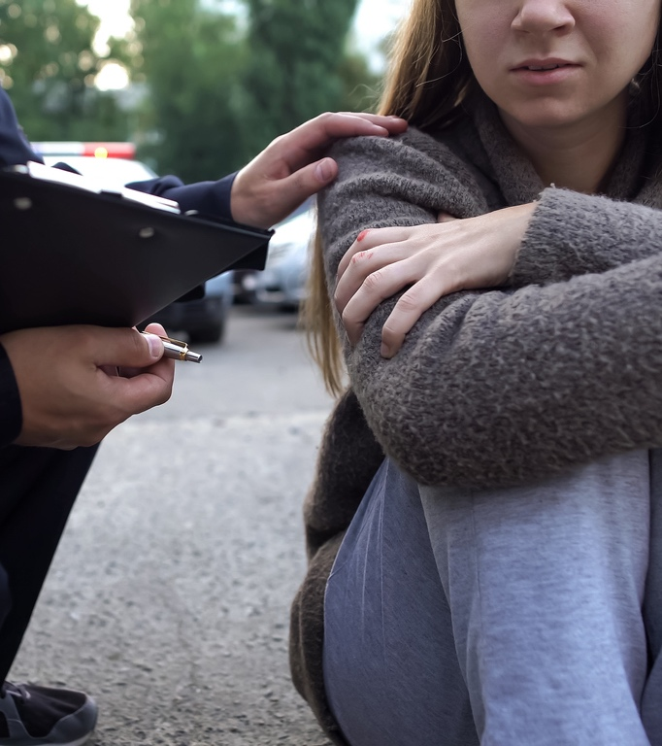
Steps to Developing Rapid Rapport
Go to person’s eye level or below
Once lucid, ask permission before entering their personal space
Ask and use the patient's name
Ask the patient what pronouns they use
Lead in slow deep breathing for someone who is anxious
Unless agitated, join person’s verbal tone and pace
Notes:
MENTIONED IN 1-HOUR – CMW: I think important to refresh since we want them to identify it in the video....
Building a relationship with the patient starts with body language and using these techniques to help the patient feel comfortable talking to you
We know that people who are revived using Narcan often have a strong emotional reaction after waking up – we want to help the patient calm down if they are in that state
Don’t stand over the patient – ask if you can come near them and get down to their eye level so they don’t feel intimated by you
Be patient and wait for the patient to become oriented
Use gender neutral terms and/or ask the patient what pronouns they use. This will help the patient feel more comfortable with you and show that you respect them as a person
If the person has a strong emotional reaction, you can do the slow deep breathing exercise we did at the beginning of the training
Join the person in their verbal tone and pace so they feel comfortable talking to you

Slide 35

Sympathy vs. Empathy Video
As you watch this video, look for examples of how the characters develop rapport!
https://brenebrown.com/videos/rsa-short-empathy/
Notes:
This video explains the difference between sympathy and empathy
As you watch this video, look out for the various rapid rapport techniques we just discussed – we will be discussing after
Instructors: Play the video either from the slide or open this link: https://brenebrown.com/videos/rsa-short-empathy/

Slide 36
Rapid Rapport Discussion
Which animal was most effective in developing rapid rapport and why?
Which rapid rapport techniques did you notice in the video?
Would you change/add anything about how the animal using rapid rapport responded?
Rapid Rapport Techniques
Go to person’s eye level or below
Once lucid, ask permission before entering their personal space
Ask and use their name
Ask the patient what pronouns they use
Lead in slow deep breathing for someone who is anxious
Unless agitated, join person’s verbal tone and pace
Notes:
Interactive Activity: Rapid Rapport Discussion (4-5 minutes)
Lead the group in a brief conversation answering the questions on the slide

Slide 37
What is Motivational Interviewing (MI)?
General approach to facilitate change
Communication style to build rapport
Not based on one scientific theory
Blending of techniques from other theories
Avoids labeling patients
Notes:
Your traditional role in EMS may be to act as a problem solver. Motivational Interviewing may require you to put that hat down for a few minutes, and just listen to the patient
Motivational Interviewing can remind you to listen to the patients’ potential motivations for seeking change and then using those motivations to help them
It is very possible that the patient may not be ready to be connected to resources that day, but using MI helps you plant a seed for if/when the patient is ready
MI recognizes that the patient is the best person to make decisions about their life and they are the only person who can really make a change in their own life
MI can help to influence/encourage progression through the stages of change

Slide 38
MI recognizes that:
The ideas most likely to succeed are those generated by the individual.
Applies principles that emphasize a collaborative relationship
Can help to influence/ encourage progression through the stages of change
Notes:
MI is based on the premise that the ideas most likely to succeed are those generated by the individual. The person will be most successful when they come up with the ideas themself
You are there to help them figure out what motivates them through a collaborative relationship
Keep the stages of behavior change in mind – you are a facilitator trying to plant a seed that will help the patient move from one stage to the next

Slide 39
MI: FOUR GUIDING PRINCIPLES
Express Empathy
Show compassion and
understanding; remember open- ended questions & affirmations can help!
Develop Discrepancy
Help person see the discrepancy between personal values/goals and current behavior
Roll with Resistance
Help guide the process...not force or drag person into treatment. Avoid direct confrontation!
Support Self-Efficacy
Listen for examples of small success. Believe in the ability to change, to support developing confidence
Notes:
There are a couple of core guiding principles that you can use throughout your interactions with patients
Motivational Interviewing: 4 Guiding Principles
Express empathy:
By showing compassion and understanding while actively listening to a patient, you can express empathy to the patient to show that you can provide support for them through a collaborative relationship
Develop discrepancy:
You can help the person see that their personal values/goals do not necessarily align with their current behavior
Be sure to do this in a non-judgmental way by separating the person from their behavior and helping them understand that their behavior of using substances or using them in an unhealthy way may not align with their personal goals/values
Roll with resistance:
Some people have a strong emotional reaction after being woken up with Narcan and you may encounter some resistance from them
Use the skills we have talked about (ex. Deep breathing, rapid rapport techniques, etc.) to help calm that person down
The goal is not to force people into treatment. The goal is to plant a seed so the person knows there are resources available for if/when they are ready
Support self-efficacy:
Pointing out any example of success can be helpful for the patient. Even if the success may seem small to you, it may actually be a big deal to the patient
For example, someone may have stopped using for 3 days. While this may not seem like a big deal to you, that was probably very difficult for the person so you can use that as a way to provide positive reinforcement and promote self efficacy
This will help the person understand that they are capable of change

Slide 40
Motivational Interviewing Techniques
1
2
3
OARS
Open Ended Questions
Affirmations
Reflect
Summarize
Eliciting Change Talk
Generating Commitment
Notes:
Motivational interviewing is a complex skill that can take a long time to master. We are not going to be experts at this by the end of a 4-hour training, but we want to give you some basic MI skills to practice when working with patients
There are 3 MI techniques we will go over today
OARS
Eliciting change talk
Generating commitment
We will start with the acronym OARS

Slide 41
1
2
3
OARS
Eliciting Change Talk
Generating Commitment
 |  |  | SUMMARIZE
 |  | REFLECT
 | AFFIRM
OPEN ENDED QUESTIONS
Notes:
Review the acronym OARS (open ended questions, affirmation, reflections, and summarization)
The goal of OARS is to build a relationship with the patient and to understand what they are going through so you can help them take the next step

Slide 42
Open Ended Questions:
1
OARS
Questions that can NOT be answered with yes or no
Purpose:
Probe widely for information
Uncover the person’s priorities & values
Avoid ‘socially desirable’ responses
Draw people out
Open-Ended questions are the foundation of OARS
OPEN-ENDED QUESTIONS
Notes:
The O in OARS stands for open-ended questions, which are questions that can NOT be answered with yes or no
Use open ended questions to understand the person’s personal motivations, goals, and reasons for using. Once you have a better understanding of that, you can help the patient figure out what they want to do next

Slide 43
Open Ended Questions Practice
1
OARS
Pick one!
The instructor.....
….went to a concert last night. Learn all you can about it!
….. is moving to a new town – learn all you can about why they are moving and why to that particular town.
….started a new job in a new field – learn about this change and what prompted it.
…has just returned from vacation. Learn all you can about why they chose that type of vacation and how it went.
Notes:
Interactive Activity: Open Ended Questions (8-10 minutes) - GROUP DISCUSSION
The purpose of this activity is to practice using open ended questions in daily life before using them in the context of talking to patients with SUD
Instructors: Please pick one of the scenarios to practice using open-ended questions.
Have students ask you at least 5 questions or probing statements (“tell me about….”) about the topic. Be sure the questions can NOT be answered with a “yes” or “no” response.

Slide 44
Yes / No vs. Open Ended
Do you want to quit smoking?
What are your thoughts about your smoking?
Do you smoke a lot of pot?
What do you like
about using pot?
Don’t you want to stop using substances?
What are your concerns about stopping using heroin?
Notes:
Now we will try asking open ended questions in the context of talking to patients post-overdose
Instructors: Go through each yes/no question In blue and show the answer. This will serve as an example for the next slide.

Slide 45
Yes / No vs. Open Ended
Can you tell me about how your substance use has affected you or those around you?
Have you had problems with substance use before?
Do you want to
go to rehab?
What do you think about the idea of recovery?
Have you been in
treatment before?
What might be some of the benefits of treatment?
Notes:
Instructors: Put the questions on the left box on the screen first and ask a volunteer to rephrase it to be an open ended question. There are no right or wrong answers, as long as the rephrased question cannot be answered with yes or no.

Slide 46

1
Affirmations
OARS
Affirm the person’s struggle, achievements, values and feelings
Emphasize a strength
Notice and appreciate a positive action, even a small one
“It takes courage to face such difficult challenges.”
“You’ve quit before; That took a lot of strength.”
“I know you didn’t expect to talk to me today, so I appreciate you doing so.”
Notes:
NOTE: The text on the left will appear immediately – when you “click” the examples will appear!
The next part of OARS is Affirmations
Affirmations help the person feel more comfortable talking to you and will likely continue the conversation
Emphasize people’s small successes (ex. Not using substances for a few days, going to a Harm Reduction Center to exchange a syringe, etc.)
Even if the success seems small to you, it may be a big accomplishment for the patient
Helping the patient feel like they accomplished something important will also support their self-efficacy and encourage them to keep trying even after a set back

Slide 47

1
OARS
Reflect
Communicates that you have listened
Serves as a ‘check’ that you correctly understood what was said
An effective, non-confrontational way to reduce resistance
Expands on the meaning of what was said
“What I’m hearing you saying is…”
“So on the one hand it seems like.. and, yet on the other hand...”
“Let me see if I heard you correctly...”
Notes:
NOTE: The text on the left will appear immediately – when you “click” the examples will appear!
Reflective listening communicates to the patient that you are listening and that you are trying to understand what they are saying
You can repeat back to them what they said to make sure you understand

Slide 48
1
OARS
Summarize
“What you’ve said is important, and I want to be sure I have it right…”
“So, what I think I hear you saying is…”
“Is there anything else you’d like to tell
  me about this?”
 |  |  | SUMMARIZE
 |  | REFLECT
 | AFFIRM
OPEN-ENDED QUESTIONS
Notes:
The last letter in OARS is Summarization
This helps bring a conclusion to the conversation and will ideally lead to next steps (ex. Giving a patient the phone number to ReachNJ or a Harm Reduction Center, leaving naloxone behind with a patient or loved one, etc.)

Slide 49
Motivational Interviewing Techniques
1
2
3
OARS
Open Ended Questions
Affirmations
Reflect
Summarize
Eliciting Change Talk
Generating Commitment
Notes:
Now we will talk about the second MI technique: eliciting change talk

Slide 50
2
Elicit Change Talk
Eliciting Change Talk
Change talk is the language/words someone uses that can ‘hint’ at and even increase the chances for a positive change.
Notes:
Change talk is the language someone may use that can hint at their potential and willingness to change their behavior
Look out for this type of talk and use it as an opportunity to motivate the person to change

Slide 51
Examples of Change Talk
2
Elicit Change Talk
Recognizes the problem:
  “This is getting pretty bad.”
  “I guess this has been affecting me more than I realized.”
  “I don't know what to do, but something has to change.
Sees the cost of continuing current behavior:
  “No one will ever hire me if I keep this up.”
  “I’m scared I will overdose again but no one will be there to help me.”
Shows concern:
  “I don’t know how I can keep up like this.”
  “Sometimes when I've been using, I just can't think or concentrate.”
Considers the possibility of changing:
  “Tell me what I would need to do if I went into treatment.”
  “I think I could stop using if I decided to.”
Expresses awareness:
  “I think my mom must be really mad at me.”
  “I feel terrible about how my drinking has hurt my family.”
Identifies the benefits of support:
  “I could probably keep my job if I stopped using.”
  “I might feel better if I got some help.”
Notes:
Review examples on the slide

Slide 52
How to Elicit Change Talk
2
Elicit Change Talk
After identifying change talk, you can start to build rapport by asking…
"How has your drug use affected you and those around you?”
"What has been the impact of substance use on your job?”
"What are some things you enjoy doing?”
Another opportunity for open ended questions.
You can engage in a way that feels natural to you – the goal is to build a connection & establish a relationship.
Notes:
Change talk increases the chances that your patient will make actual changes.
This is another opportunity to use the open ended questions we practiced earlier
Review examples on slide
You should engage in the way that feels most comfortable to you – give a compliment, make a connection, build rapid rapport, etc.

Slide 53
Developing Discrepancy
2
Elicit Change Talk
Help the person see the discrepancy between present behavior and their desired behaviors or values
Listen carefully to the person’s statements about personal values and connections to community, family, and faith
If the person is showing concern about the effects of their behavior, highlight the difference to heighten awareness and acknowledgment of discrepancy
Notes:
Motivation for change is strengthened when the person sees the discrepancies between their current situation and their hopes for the future
Your role is to help focus the person's attention on how current behavior differs from ideal or desired behavior
Discrepancy is initially highlighted by increasing the person's awareness of the negative personal, familial, or community consequences of a risky behavior and helping them confront the substance use that contributed to the consequences
The patient should be the one to come up with the arguments for change, not the healthcare provider

Slide 54
How to Develop Discrepancy
2
Elicit Change Talk
1. Ask for the ‘Pros’ of the current behavior:
  “Tell me about what you enjoy when getting high.”
2. Ask for the ‘Cons’ of the current behavior:
  “What worries you about using drugs?”
  “How do drugs affect your family life?”
  “What might be different in your life if you stopped using?”
Once the person begins to understand how the current behavior conflicts with personal values, amplify and focus on this discordance until they can see this discrepancy and consider a commitment to change.
Notes:
Asking a patient for the pros and cons of their current behavior can be effective in helping them understand the discrepancy between their behavior and their values/goals
Review examples on slide

Slide 55
Motivational Interviewing Techniques
1
2
3
OARS
Open Ended Questions
Affirmations
Reflect
Summarize
Eliciting Change Talk
Generating Commitment
Notes:
The last MI technique is generating commitment

Slide 56
3
Generating Commitment
Generate Commitment
Generating commitment should follow closely after a patient begins to talk about change
Provide support to help implement the effort:
  “What would you like to do next?”
  “How can we help you?”
  “What have you tried before? Why did it work/not work?”
  “What is most important to you right now?”
Your role is to support the individual and connect them with the appropriate resources to accomplish their next step
Notes:
The best ideas for next steps come from within the individual (intrinsic, goal-based motivation)
Meet the patient where they are at instead of telling them what to do next
Any type of commitment to a step in the direction of safer drug use/no drug use is a win and make sure the patient knows that
Your role is not to develop a care plan, but to connect the patient with resources that can help them accomplish what they want their next steps to be
Something that seems like a small change to you may be a big win for the patient

Slide 57

RESIST
RESIST telling person what to do:
Avoid telling, directing, or convincing the person about the right path to good health
UNDERSTAND
UNDERSTAND the person’s motivation
Seek to understand their values, needs, abilities, motivations and potential barriers to changing behaviors
LISTEN
LISTEN with Empathy
Effective listening skills are essential to understand what will motivate the patient, as well as the pros and cons of their situation
EMPOWER
EMPOWER the person
Work with the individual to set achievable goals and to identify techniques to overcome barriers

Slide 58
Notes:
Prepare for Role Playing exercise

Slide 59
Motivational Interviewing Role Playing Scenarios
14-year-old overdosed teenager at home
A call comes in from Central Dispatch that a suburban middle-class neighborhood at 10 pm, regarding a 14-year-old female who was found by her parents in an upstairs bathroom. She was found by her parents unconscious on the bathroom floor. The parents were directed by Dispatch to begin CPR. The parents are in their mid 50s and have very limited knowledge of drug use.
Upon your arrival you notice some glassine packets on the floor behind the toilet containing what appears to be Oxycontin. The parents do not recognize their daughter has overdosed. In talking to the parents they are shocked to hear their daughter has been using drugs, and have no knowledge of any prior use and are in denial of her use. She is reversed from the overdose and immediately begins sobbing. The parents are supportive but in denial.
2. Mother overdoses with three children at home
You are contacted by Central Dispatch to respond to a residential address where a nine-year-old child called 911 reporting his mother won’t wake up. Upon arrival at the home, you go to the kitchen and find the police present, having reversed the mother from an apparent Opiate (suspected fentanyl ) overdose. She appears more embarrassed then angry or fearful, as you begin to interact with her.
You are told there are three children in the home, ages nine, seven and four. The father (35 yrs) and mother (29 yrs) are separated, with the father living with his parents approximately 5 miles away. From her reaction, you believe this mother may have been reversed before.
3. Pregnant Single Women overdoses in library rest room
You receive a call that a young woman has been found in the stall of a library restroom on the floor and unconscious. Central Dispatch said the caller hung up before they could get any further information. You are near library so arrive approximate two minutes from receiving the call. You enter the restroom and find the young Woman, pregnant (approx. 5 months) on the floor. Her breathing is shallow and guttural, and her lips and fingertips are blue.
4. Middle-aged man unresponsive in local diner restroom
You have arrived at about 9:00pm with your fellow responders to find a man, approximately 50 years of age, in the men’s room of a local diner, unconscious. He was found by the owner of the diner, who says he has never see the man there before. He appears to be homeless, as there is a larger cart of belongings near him, and there is a syringe lying next to him. The patient also appears to have a wound on his forearm that is not consistent with the injection site and may be associated with xylazine use.
Notes:
**NOTE: Scenario 4 added a wound/xylazine component
Interactive Activity: Role Playing (30-60 minutes, depending on how much time you have left)
Break the class into groups of 3-5 people
Encourage people to get up and meet new people for this exercise
If you have a group with mixed backgrounds, make sure at least 1 person from EMS or another first responder is in each group)
Tell the students that they can pick one of the scenarios on the slide (or the instructor can assign each group a scenario) and they should practice role playing it like the instructors just did
Assign roles to each member of the group
1 patient
1-2 first responders
1-2 observers
Another role if necessary for the specific scenario (ex. Parent, bystander)
At the end of the scenario, discuss any feedback (positive and constructive) that the group has for each other – there is always room for improvement
If the group finishes early, they can try doing the exercise again but switching up the roles or try a different scenario on the slide
Instructors: If possible, assign 1 instructor to each group or if there are not enough instructors for each group, walk around to make sure each group is on the right track
ALTERNATE APPROACH:
Break class into groups and assign role plays
Let them review for 10 minutes or so, and then ask for volunteer group to go first, and do role play in front of full class.
THIS ALLOWS for all to observe and learn from each other.
IMPORTANT: YOU ARE STILL facilitating the process!!
1-Check in with 'the patient' to see how they felt in the process;
2 – Check in with the "EMT"
AND THEN GO TO GROUP for 'Positive feedback' -- then ideas to improve – and finish with more positive

Slide 60
Role Playing Discussion Questions
Which parts of this felt comfortable for you? What felt uncomfortable?
How is this similar or different than how you typically interact with a patient post-overdose?
What skills from the training did your group use?
What feedback did you give your group members?
Notes:
Interactive Activity: Discussion about Role Playing (10-15 minutes)
When you come back together as a group after the role playing, start a discussion about how the activity went

Slide 61

“If you didn’t offer me treatment when
I didn’t want it, I wouldn’t be here to
take the treatment when I was ready.”
Notes:
We started the training with this quote and we just want to remind you of it at the end of today’s training
Our goal is to apply the communication techniques you learned today out in the field to connect with patients and to encourage them to get help when they are ready

Slide 62
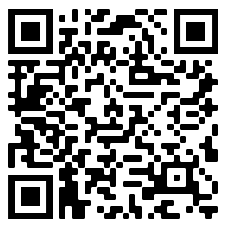
Contact Information
Evaluation
INSTRUCTOR NAME
EMAIL
INSTRUCTOR NAME
EMAIL
Five Minutes to Help
5MinToHelp@doh.nj.gov
go.rutgers.edu/eval5mins
Notes:
Participants MUST fill out the evaluation to receive 4 CEUs
Instructors:
Make sure you edit this slide to include all of the instructors’ names and contact information (email, phone, etc.)
If you would like to receive a copy of the evaluation results from your class, please email 5MinToHelp@doh.nj.gov
You can direct people to the 5MinToHelp@doh.nj.gov email address if they have feedback or questions about Five Minutes to Help or want more information about naloxone leave behind
After your class, please email 5MinToHelp@doh.nj.gov the number of people who attended your class and any feedback/comments you have

